Slide 1
ELEMENTS OF TRANSPORT PROTOCOL
By
Mrs. E. Himabindu
Asst.Professor
SVIT

Slide 2
Contents
Addressing
Connection Establishment
Connection Release
Error Control and Flow Control
Multiplexing
Crash Recovery

Slide 3
Introduction
The transport service is implemented by a transport protocol used between the two transport entities. In some ways, transport protocols resemble the data link protocols. However, significant differences between the two also exist. These differences are due to major dissimilarities between the environments in which the two protocols operate.

Slide 5
Difference between data link layer and transport layer
 | Data link layer | Transport Layer
Addressing | No explicit addressing needed, as routers communicate directly over point-to-point links. | Requires explicit addressing using unique Transport Service Access Points (TSAPs) or port numbers.
Connection Establishment: | Simple connection setup over point-to-point links; the other end is always present. | Complex connection establishment involving setup, maintenance, and teardown of connections.
Packet Delay and Duplication Handling: | Minimal delay and duplication within the network. | Potential for delay and packet duplication, requiring special protocols for correct data transport.
Buffering and Flow Control | Fixed buffering for each line. | Variable buffering due to numerous connections with fluctuating bandwidth; different approach needed for flow control.

Slide 6
The data link layer is like a local courier service, responsible for reliable communication between adjacent nodes, while the transport layer acts as a national postal service, handling end-to-end delivery of data between different hosts across the entire network.

Slide 7
Addressing in Transport Layer
When an application process wants to set up a connection to a remote application process, it needs to specify the destination. Transport addresses are used for this purpose, and these endpoints are called Transport Service Access Points (TSAPs). TSAPs are specific endpoints in the transport layer, analogous to ports in the Internet.
In contrast, the network layer has Network Service Access Points (NSAPs), which are network layer addresses, and IP addresses are examples of NSAPs.

Slide 9
A possible scenario for a transport connection is as follows:
1. A mail server process attaches itself to TSAP 1522 on host 2 to wait for an incoming call. A call such as our LISTEN might be used, for example.
2. An application process on host 1 wants to send an email message, so it attaches itself to TSAP 1208 and issues a CONNECT request. The request specifies TSAP 1208 on host 1 as the source and TSAP 1522 on host 2 as the destination. Now a transport connection is established between the application process and the server.
3. The application process sends over the mail message.
4. The mail server responds to say that it will deliver the message.
5. The transport connection is released.

Slide 10
Stable TSAP Addresses:
In some cases, services in the transport layer have stable TSAP addresses that are known in advance. For example, the /etc/services file on UNIX systems lists well-known services and their corresponding ports (TSAP addresses).
User processes may want to communicate with other user processes that do not have known TSAP addresses or may exist only temporarily. This poses a challenge as stable TSAP addresses are not sufficient for all communication scenarios.

Slide 11
Portmapper:
To address the challenges, an alternative approach involves using a special process called a portmapper. The portmapper acts as a mapping service, similar to a directory assistance operator in the telephone system. Users can query the portmapper for the TSAP address corresponding to a specific service name (e.g., 'BitTorrent'). The portmapper responds with the TSAP address of the desired service, enabling the user to establish a connection to it.

Slide 12
Initial Connection Protocol:
Another alternative scheme is the initial connection protocol, where a process server (e.g., inetd on UNIX systems) acts as a proxy for less frequently used servers.
When a user wants to access a service, they connect to the process server with the desired TSAP address.
If the requested service is not currently active, the user gets connected to the process server, which spawns the requested server and passes the connection to it.

Slide 14
After it gets the incoming request, the process server spawns the requested server, allowing it to inherit the existing connection with the user. The new server does the requested work, while the process server goes back to listening for new requests.

Slide 15
Connection Establishment
Establishing a connection in a network is tricky due to the possibility of packet loss, delay, corruption, and duplication.
In a congested network with high packet retransmission rates, it becomes difficult to distinguish between delayed duplicate packets and new packets.
Worst-Case Scenario:
In the worst-case scenario, delayed duplicate packets can lead to serious problems, such as a connection setup request being duplicated and causing unintended transactions.

Slide 16
Packet lifetime can be restricted to a known maximum using one (or more) of the following techniques:
1. Restricted network design.
It is difficult to restrict the network design, given that internets may range from a single city to international in scope.
2. Putting a hop counter in each packet.
By enforcing a period T, we can ensure that all traces of a packet are gone after T seconds, including any delayed duplicates and their acknowledgments.

Slide 17
3. Timestamping each packet.
To prevent delayed duplicate issues for connection establishment, Tomlinson proposed using a time-of-day clock at each host to generate initial sequence numbers for connections.
Each host uses the low-order k bits of its clock value as the initial sequence number for a new connection. The sequence numbers should have a large enough space to avoid wrapping around before delayed duplicates are eliminated.

Slide 18
Three-Way Handshake:
To verify that the connection request is current and avoid delayed duplicate issues during connection establishment, a three-way handshake is used.
The three-way handshake involves the initiating host sending a CONNECTION REQUEST segment, the receiving host replying with an ACK segment and its initial sequence number, and then the initiating host acknowledging the received sequence number.

Slide 20
Handling Delayed Duplicate Control Segments:
In the presence of delayed duplicate CONTROL segments, the three-way handshake ensures that delayed duplicates are detected and rejected.
The ACKnowledgment from the receiving host during the handshake helps to identify whether a connection request is genuine or a delayed duplicate.

Slide 21
Connection Release
There are two styles of terminating a connection: asymmetric release and symmetric release.
Asymmetric release is abrupt and may result in data loss.

Slide 23
Symmetric release treats the connection as two separate unidirectional connections and requires each one to be released separately. One can envision a protocol in which host 1 says ‘‘I am done. Are you done too?’’ If host 2 responds: ‘‘I am done too. Goodbye, the connection can be safely released.’’

Slide 24
The Two-Army Problem:
The Two-Army Problem is a theoretical scenario that demonstrates the challenge of achieving agreement when using unreliable communication channels.

Slide 26
In the Two-Army Problem, there are three armies: a white army encamped in a valley and two blue armies on the surrounding hillsides. The white army is individually larger than either blue army, but together, the blue armies are larger than the white army. The blue armies want to synchronize their attacks to defeat the white army. However, their only communication medium is unreliable messengers who can be captured while delivering messages into the valley.
The problem is that no protocol exists that ensures both sides will disconnect simultaneously, as there is no way to guarantee that essential messages will be received.

Slide 27
Three-Way Handshake for Connection Release:
To avoid data loss during connection release, a three-way handshake protocol is used.
The initiating host sends a DISCONNECTION REQUEST (DR) segment, and the receiving host responds with a DR segment and starts a timer in case its DR is lost.
When the original sender receives the DR segment, it sends back an ACK segment and releases the connection.
If the final ACK segment is lost, a timer ensures the connection is released anyway.

Slide 30
Half-Open Connections:
The three-way handshake protocol is usually adequate, but it can fail if both the initial DR and all subsequent retransmissions are lost.
This can lead to half-open connections, where one side has released the connection, but the other side is still fully active.
Handling Half-Open Connections:
To handle half-open connections, a rule can be introduced, stating that if no segments arrive for a certain period, the connection is automatically disconnected.
This ensures that if one side disconnects, the other side will detect the lack of activity and also disconnect.

Slide 31
Application Involvement in Disconnecting:
The lesson here is that the transport user (application) must be involved in deciding when to disconnect, as the transport entities themselves cannot cleanly solve the issue.
Web Server Example:
Many Web servers use a RST packet for an abrupt close of the connection, as they know the data exchange pattern with the client and can ensure the data transfer is complete before closing the connection.

Slide 32
Error Control and Flow Control
Error control and flow control are essential aspects of managing connections while they are in use. They ensure data reliability and prevent fast transmitters from overwhelming slow receivers. These mechanisms have similarities with the techniques used in the data link layer for error detection and Automatic Repeat reQuest (ARQ).

Slide 33
Error Control
Error control in the transport layer ensures that data is delivered with the desired level of reliability.
Transport layer protocols use end-to-end error-checking codes (e.g., CRC or checksum) to detect errors in segments as they traverse the entire network path. A frame carries an error-detecting code (e.g., a CRC or checksum) that is used to check if the information was correctly received.
If an error is detected, the sender may retransmit the affected segments until they are successfully received and acknowledged by the receiver.

Slide 34
Flow Control
Flow control prevents a fast sender from sending data faster than a slow receiver can process it, preventing receiver overflow.
A frame carries a sequence number to identify itself and is retransmitted by the sender until it receives an acknowledgement of successful receipt from the receiver. This is called ARQ (Automatic Repeat reQuest). And it provides both error control anf flow control mechanisms.
There is a maximum number of frames that the sender will allow to be outstanding at any time, pausing if the receiver is not acknowledging frames quickly enough. If this maximum is one packet the protocol is called stop-and-wait. Larger windows enable pipelining and improve performance on long, fast links.

Slide 35
The sliding window protocol combines these features and is also used to support bidirectional data transfer.
Transport layer protocols use sliding window flow-control mechanisms, limiting the number of unacknowledged segments sent by the sender at any given time.
If the window size is one packet, it is called stop-and-wait. Larger window sizes allow pipelining and better performance on long, fast links.

Slide 36
End-to-End Argument:
The transport layer's error-checking mechanism is considered end-to-end, protecting the segment throughout the entire network path. In contrast, link layer error-checks only protect the frame while it crosses a single link and may not guarantee end-to-end correctness.
The end-to-end argument emphasizes the importance of transport layer checks for overall correctness, with link layer checks enhancing performance.

Slide 37
Dynamic Buffer Allocation:
Transport layer protocols dynamically allocate buffers at the receiver based on the required window size for the sender's sliding window.
Dynamic buffer allocation allows efficient memory utilization and adapts to the traffic patterns and available resources in the network.
TCP uses a dynamic sliding window to implement both flow control and congestion control.

Slide 39
Flow Control vs. Congestion Control
Flow control ensures that the sender does not overwhelm the receiver by matching the sender's window size to the receiver's buffer capacity.
Congestion control aims to prevent network congestion by adjusting the window size based on the network's carrying capacity, considering factors like network throughput and round-trip time.

Slide 40
Error control and flow control are vital mechanisms that enable reliable data transmission and effective bandwidth utilization in the transport layer. Transport protocols use sliding window techniques and dynamic buffer allocation to manage data flow and adapt to network conditions.

Slide 41
Multiplexing in the Transport Layer
Multiplexing is the process of sharing several conversations (connections) over the same network address, virtual circuits, or physical links. It plays a role in several layers of the network architecture, including the transport layer. There are two main scenarios where multiplexing is used in the transport layer:

Slide 42
Address Multiplexing:
When a host has only one network address (e.g., IP address), all transport connections on that machine must use the same address.
To distinguish between different transport connections, a mechanism is needed to tell which process should receive a received segment. This process is called address multiplexing.
Each transport connection is identified using a unique port number or identifier in the transport layer header. This combination of IP address and port number helps route segments to the correct process on the receiving host.

Slide 44
Inverse Multiplexing
In some scenarios, a host may have multiple network paths available, and a user might need more bandwidth or higher reliability than a single path can provide.
Inverse multiplexing involves distributing traffic among multiple network paths on a round-robin basis, effectively combining the bandwidth of individual paths.
SCTP (Stream Control Transmission Protocol) is an example of a transport protocol that supports inverse multiplexing by running a connection using multiple network interfaces.

Slide 45
Crash Recovery
Crash recovery refers to the process of recovering from host or router crashes during long-lived connections or sessions.
Recovery from Network and Router Crashes:
If the transport entity is entirely within hosts, recovery from network and router crashes is relatively straightforward. Lost segments are expected, and retransmissions can be used to cope with them.
Recovery from Host Crashes:
Recovery from host crashes is more complex. The scenario involves a client sending a file to a server using a stop-and-wait protocol. The server's transport layer passes incoming segments to the transport user one by one. The server crashes during the transmission, and upon recovery, it broadcasts a segment to other hosts, requesting clients to inform it about the status of open connections.

Slide 47
Infeasibility of Transparent Recovery:
The conclusion is that, due to the inherent limitations of events occurring sequentially, transparent recovery from host crashes is not achievable at the same layer. Recovery from a crash in layer N can only be done by layer N + 1, provided the higher layer retains enough status information.
End-to-End Principle:
The transport protocol should ideally be end-to-end and not heavily chained like lower layers. This principle aims to ensure that higher layers receive meaningful acknowledgments.

Slide 48
Complexity of Achieving True End-to-End Acknowledgment:
Achieving a true end-to-end acknowledgement, where the receipt of an acknowledgment guarantees the completion of intended actions, is challenging and might be impossible in certain scenarios.

Slide 49
Internetworking

Slide 50
Internetworking
Interworking refers to the process of connecting and enabling communication between different types of networks or systems.
It involves the seamless exchange of data between multiple heterogeneous networks, allowing users on one network to communicate with users on other networks.
Interworking is essential in today's interconnected world, where numerous networks with different technologies and protocols coexist.

Slide 51
Key points about internetworking:
Heterogeneity (how networks differ): Networks can differ in many ways, including protocols, addressing schemes, packet sizes, quality of service, reliability, security mechanisms, and more.
Interworking deals with addressing and resolving these differences to enable communication between networks.

Slide 53
2. Challenges (how networks can be connected): Connecting different networks can be challenging due to differences in addressing, packet sizes, ordering, quality of service, and security, among other factors. These differences must be accommodated to ensure data transmission across the interconnected networks.

Slide 55
3. Multiprotocol Routers: To enable interworking between different networks, multiprotocol routers are used. These routers are capable of handling multiple network protocols and can translate packets between different types of networks.

Slide 56
Tunneling: Tunneling is a technique used to connect isolated hosts or networks using other networks as an overlay. It involves encapsulating packets within packets, effectively creating a "tunnel" through which data can pass from one network to another.
Tunneling is useful when the source and destination hosts are on the same type of network, but there is a different network (the tunnel) in between.

Slide 57
An analogy to tunneling

Slide 58
Example

Slide 59
Internetwork Routing: Internetwork routing involves the process of determining the paths that data packets take through an Internet.
It poses several challenges due to the diversity of networks, varying routing algorithms, different operator preferences, etc.
Internetwork Routing is typically handled by a two-level routing algorithm, where each network (or Autonomous System - AS) uses an intradomain or interior gateway protocol for internal routing, and an interdomain or exterior gateway protocol for routing between networks.

Slide 60
key points to note about Internetwork Routing
Intradomain Routing (Interior Gateway Protocol - IGP)
Interdomain Routing (Exterior Gateway Protocol - EGP)
Autonomous System (AS)
Routing Policies
Two-Level Routing
BGP (Border Gateway Protocol)

Slide 61
Fragmentation
Networks impose maximum packet sizes, and when a large packet needs to travel through a network with a smaller maximum packet size, fragmentation can occur. Fragmentation involves breaking the large packet into smaller fragments, which can then be reassembled at the destination.
Packet fragmentation is a process used in computer networks to break large data packets into smaller fragments to fit within the maximum packet size allowed by the underlying network links

Slide 62
Reason for packet fragmentation
Each network or link in a network imposes a maximum size on its packets due to hardware limitations, operating system buffer sizes, protocol specifications, compliance with standards, reducing error-induced retransmissions, or preventing one packet from occupying the channel for too long

Slide 63
Fragmentation Strategies:
Transparent Fragmentation: In this strategy, routers break up oversized packets into fragments, and each fragment is addressed to the same exit router where they are recombined. Subsequent networks are unaware that fragmentation occurred. However, this approach requires the exit router to know when all fragments have arrived and may constrain routing options.
Nontransparent Fragmentation: In this strategy, routers do not recombine fragments; each fragment is treated as an independent packet. Reassembly is performed only at the destination host. This approach requires less work for routers but adds overhead due to fragment headers.

Slide 66
Path MTU Discovery: Path MTU discovery is a technique used to determine the smallest maximum transmission unit (MTU) along the path between the source and destination. This allows the source to send packets of the appropriate size, reducing the need for fragmentation.
The modern Internet primarily uses Path MTU discovery to avoid fragmentation.

Slide 68
THE INTERENT TRANSPORT PROTOCOLS : UDP & TCP
BY
Mrs. E. Himabindu
Asst. Professor
SVIT

Slide 69
Contents
User Datagram Protocol (UDP)
Remote Procedure Call (RPC)
Real –Time Transport Protocols (RTP &RTCP)
Playout with Buffering and Jitter Control

Slide 70
User Datagram Protocol (UDP)
The Internet protocol suite supports a connectionless transport protocol called UDP (User Datagram Protocol). UDP provides a way for applications to send encapsulated IP datagrams without having to establish a connection.
UDP transmits segments consisting of an 8-byte header followed by the payload.

Slide 71
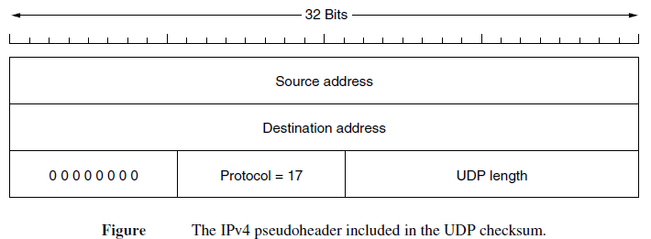
The pseudoheader for the case of IPv4 is shown in Fig. given below. It contains the 32-bit IPv4 addresses of the source and destination machines, the protocol number for UDP (17), and the byte count for the UDP segment. Including the pseudoheader in the UDP checksum computation helps detect misdelivered packets

Slide 72
UDP does not provide flow control, congestion control, or retransmission upon receipt of a bad segment; these responsibilities are left to the user processes. It is useful for applications that require precise control over packet flow, error control, or timing.
UDP is often used for client-server interactions, where the client sends short requests and expects short replies from the server.

Slide 73
Remote Procedure Call (RPC)
RPC allows programs to call procedures located on remote hosts, making network applications easier to program and more familiar to deal with.
When a process on machine 1 calls a procedure on machine 2, the calling process on 1 is suspended and execution of the called procedure takes place on 2. Information can be transported from the caller to the callee in the parameters and can come back in the procedure result. No message passing is visible to the application programmer.
It involves client and server stubs to hide the fact that the procedure call is not local.

Slide 74
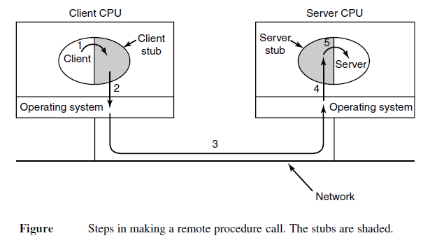
Step 1 is the client calling the client stub.
This call is a local procedure call, with the parameters
pushed onto the stack in the normal way.
Step 2 is the client stub packing the parameters into a message and making a system call to send the message. Packing the parameters is called marshaling.
Step 3 is the operating system sending the message from the client machine to the server machine.
Step 4 is the operating system passing the incoming packet to the server stub.
Finally, step 5 is the server stub calling the server procedure with the unmarshaled parameters. The reply traces the same path in the other direction.

Slide 75
It is widely used in various networking applications, but some restrictions are needed to make it work effectively in practice.

Slide 76
Real-Time Transport Protocols (RTP and RTCP)
RTP (Real-time Transport Protocol) is used to multiplex several real-time data streams into a single stream of UDP packets for real-time multimedia applications. The UDP stream can be sent to a single destination (unicasting) or to multiple destinations (multicasting).
There are two aspects of real-time transport. The first is the RTP protocol for transporting audio and video data in packets. The second is the processing that takes place, mostly at the receiver, to play out the audio and video at the right time.

Slide 77
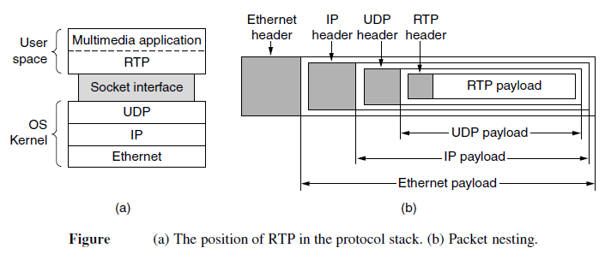

Slide 79
RTCP
RTP has a little sister protocol (little sibling protocol?) called RTCP (Realtime Transport Control Protocol). It is defined along with RTP in RFC 3550 and handles feedback, synchronization, and the user interface. It does not transport any media samples.
feedback on delay, variation in delay or jitter, bandwidth, congestion, and other network properties to the sources.

Slide 80
Playout with Buffering and Jitter Control
To deal with jitter in multimedia applications, receivers use buffering to smooth out playback.
Jitter control involves determining the playback point and adapting it based on measured jitter to ensure smooth playback.
Short buffers are used for live applications like videoconferencing, while streaming applications use larger buffers to ensure timely packet reception.

Slide 81
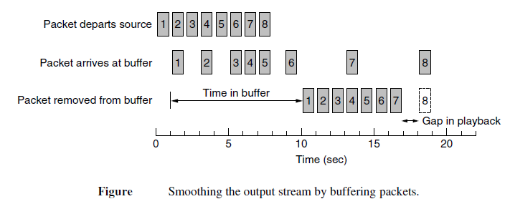

Slide 82
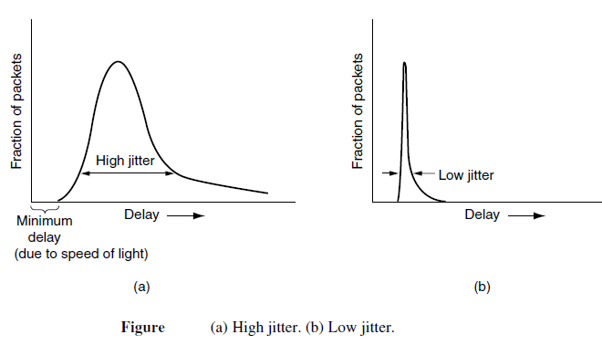
playback point

Slide 83
TCP

Slide 84
Transmission Control Protocol
TCP is a connection oriented protocol; it creates a virtual connection between two TCPs to send data. In addition, TCP uses flow and error control mechanisms at the transport level. In brief, TCP is called a connection-oriented, reliable transport protocol. It adds connection-oriented and reliability features to the services of IP.
Here, we will discuss about
TCP Services
TCP Segment
TCP Features
A TCP Connection
Flow Control
Error Control

Slide 85
TCP Services
1 Process-to-Process Communication
TCP provides process-to-process communication using port numbers. Below Table lists some well-known port numbers used by TCP.

Slide 87
2 Stream Delivery Service
TCP, on the other hand, allows the sending process to deliver data as a stream of bytes and allows the receiving process to obtain data as a stream of bytes. TCP creates an environment in which the two processes seem to be connected by an imaginary "tube“ that carries their data across the Internet. This imaginary environment is showed in below Figure. The sending process produces (writes to) the stream of bytes, and the receiving process consumes (reads from) them.

Slide 89
TCP segments
At the transport layer, TCP groups a number of bytes together into a packet called a segment. TCP adds a header to each segment (for control purposes) and delivers the segment to the IP layer for transmission. The segments are encapsulated in IP datagrams and transmitted.
This entire operation is transparent to the receiving process. Segments may be received out of order, lost, or corrupted and resent. All these are handled by TCP with the receiving process unaware of any activities. Above fig shows how segments are created from the bytes in the buffers.

Slide 91
TCP Segment Format

Slide 92
TCP Features
Full-Duplex Communication
TCP offers full-duplex service, in which data can flow in both directions at the same time. Each TCP then has a sending and receiving buffer, and segments move in both directions.
Connection-Oriented Service
TCP is a connection-oriented protocol. When a process at site A wants to send and receive data from another process at site B, the following occurs:
1. The two TCPs establish a connection between them.
2. Data are exchanged in both directions.
3. The connection is terminated.

Slide 93
Reliable Service
TCP is a reliable transport protocol. It uses an acknowledgment mechanism to check the safe and sound arrival of data. We will discuss this feature further in the section on error control.
Numbering System
There are two fields called the sequence number and the acknowledgment number. These two fields refer to the byte number and not the segment number.
Byte Number The bytes of data being transferred in each connection are numbered by TCP. The numbering starts with a randomly generated number. For example, if the random number happens to be 1057 and the total data to be sent are 6000 bytes, the bytes are numbered from 1057 to 7056. We will see that byte numbering is used for flow and error control.
Sequence Number After the bytes have been numbered, TCP assigns a sequence number to each segment that is being sent. The sequence number for each segment is the number of the first byte carried in that segment.
Acknowledgment Number The value of the acknowledgment field in a segment defines the number of the next byte a party expects to receive. The acknowledgment number is cumulative.

Slide 94
Flow Control
TCP, provides flow control. The receiver of the data controls the amount of data that are to be sent by the sender. This is done to prevent the receiver from being overwhelmed with data. The numbering system allows TCP to use a byte-oriented flow control.
Error Control
To provide reliable service, TCP implements an error control mechanism. Although error control considers a segment as the unit of data for error detection (loss or corrupted segments), error control is byte-oriented, as we will see later.
Congestion Control
TCP takes into account congestion in the network. The amount of data sent by a sender is not only controlled by the receiver (flow control), but is also determined by the level of congestion in the network.

Slide 95
TCP Connection Establishment
When establishing a TCP connection, a three-way handshake is used. One side (usually the server) waits passively using the LISTEN and ACCEPT primitives, while the other side (the client) initiates an active connection using the CONNECT primitive. The client sends a SYN segment to the server with the SYN bit on and the ACK bit off, signaling its desire to connect. The server responds with a SYN+ACK segment, acknowledging the client's request. Upon receiving the SYN+ACK, the client sends an ACK segment to the server, completing the three-way handshake. This process is illustrated in Figure 6-37(a), where SYN segments consume 1 byte of sequence space.
In case two hosts simultaneously try to establish connections between the same sockets, the connections are identified by their endpoints. Only one connection is established, and the sequence of events determines which connection is accepted.

Slide 97
SYN Flooding Attack This happens when a malicious attacker sends a large number of SYN segments to a server, pretending that each of them is corning from a different client by faking the source IP addresses in the datagram's.
To prevent resource exhaustion from malicious SYN flood attacks, SYN cookies can be used. Instead of remembering the sequence number, a host generates a cryptographic sequence number and puts it in the outgoing segment. If the handshake completes, the host can regenerate the correct sequence number, enhancing security against attacks.

Slide 98
TCP Connection Release
TCP connections are released in a full-duplex manner, but each side can release its direction independently. To release a connection, either party sends a TCP segment with the FIN bit set, indicating that it has no more data to send. Upon acknowledging the FIN, data flow in that direction is shut down, while data can still flow in the other direction. Once both directions are closed, the connection is released.

Slide 99
Typically, four TCP segments are used to release a connection: two FIN segments and their corresponding ACK segments. However, the first ACK and second FIN can be combined into one segment, reducing the total to three.
If both ends of a connection send FIN segments simultaneously, the connection is similarly closed, and the release process initiates. To avoid the two-army problem, timers are employed. If no response to a FIN is received within two maximum packet lifetimes, the sender of the FIN proceeds to release the connection. The other side will eventually notice the lack of response and also time out. Although not perfect, this solution is effective in most cases.

Slide 100
TCP Connection Management Modeling

Slide 101
Each connection starts in the CLOSED state and transitions through states like LISTEN, SYN RCVD, SYN SENT, and ESTABLISHED as connections are established. Similarly, when releasing a connection, TCP transitions through states like FIN WAIT 1, FIN WAIT 2, CLOSING, CLOSE WAIT, and TIME WAIT before returning to the CLOSED state. This finite state machine captures the complex sequence of events involved in connection establishment and release.

Slide 103
TCP Sliding Window
TCP's sliding window mechanism separates the issues of acknowledging received segments and managing the receiver buffer. For instance, consider a scenario where the receiver has a 4096-byte buffer. If a 2048-byte segment is correctly received, the receiver acknowledges it, but its available buffer space is reduced to 2048 bytes. Consequently, it advertises a window of 2048 starting from the next expected byte. The sender should refrain from sending more data until the receiver's buffer has space.

Slide 105
When the receiver's buffer is completely filled, it may advertise a window size of 0, indicating that it can't currently accept any more data. The sender then pauses until the receiver frees up buffer space.
When the window is 0, the sender may not normally send segments, with two exceptions. First, urgent data may be sent, for example, to allow the user to kill the process running on the remote machine. Second, the sender may send a 1-byte segment to force the receiver to reannounce the next byte expected and the window size. This packet is called a window probe. The TCP standard explicitly provides this option to prevent deadlock if a window update ever gets lost.

Slide 106
Optimizing for Interactive Applications: To optimize bandwidth usage, TCP implementations often employ techniques like delayed acknowledgements. Acknowledgements and window updates are delayed for a short period (e.g., up to 500 milliseconds) to accumulate more data to send in a single segment. This approach effectively reduces the number of packets and improves overall efficiency. However, delayed acknowledgements might not be suitable for interactive applications like games, where rapid updates are essential.

Slide 107
Nagle's algorithm offers another optimization. It suggests buffering small pieces of data until the first piece is acknowledged. Then, all the buffered data is sent in one TCP segment. This approach limits the number of short packets and optimizes data transmission.

Slide 108
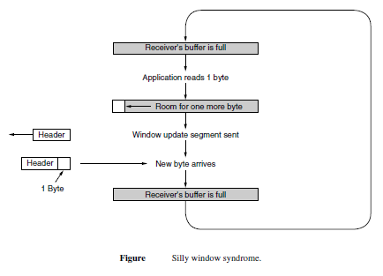
Silly Window Syndrome: The "silly window syndrome" occurs when data are passed to the sending TCP entity in large blocks, but an interactive application on the receiving side reads data only 1 byte at a time. It causes inefficiencies due to frequent acknowledgements and window updates.

Slide 109
Clark's solution suggests delaying window updates until a significant amount of buffer space is available. Additionally, the sender can wait to send until a full segment or a significant portion of the receiver's buffer is ready.

Slide 110
Out-of-Order Segments and Cumulative Acknowledgements: TCP handles out-of-order segments that may arrive at the receiver. Instead of discarding them, the receiver buffers the data until they can be passed to the application in the correct order. Acknowledgements are sent as cumulative acknowledgements, meaning that when a receiver acknowledges a segment, it acknowledges all bytes up to the last byte of the acknowledged segment.

Slide 111
Congestion Control
Congestion occurs when the load on a network exceeds its capacity, causing queues to build up. The network layer detects congestion and tries to manage it by dropping packets. The transport layer, particularly TCP, receives congestion feedback from the network layer and adjusts its traffic rate accordingly.

Slide 112
AIMD (Additive Increase Multiplicative Decrease): AIMD is a control law used in congestion control. TCP implements AIMD using a congestion window that determines the number of bytes the sender can have in the network at any time. The window size is adjusted based on congestion signals received from the network.
Congestion Window and Flow Control Window: TCP maintains both a congestion window and a flow control window. The effective window size is the smaller of these two windows. The flow control window limits how much data the receiver can buffer, while the congestion window adjusts the sender's data transmission rate.

Slide 113
TCP Congestion Control Evolution: The development of modern TCP congestion control mechanisms was largely driven by Van Jacobson's work in response to congestion collapse incidents in the early Internet. Congestion collapse led to the development of TCP congestion control algorithms like TCP Tahoe and TCP Reno.
Slow Start: Slow start is an algorithm used in congestion control that allows the sender to gradually increase the congestion window size after the connection is established. It starts with a small initial window and doubles it every round-trip time until it reaches a threshold.

Slide 114
Fast Retransmission and Fast Recovery: Fast retransmission is a mechanism that triggers retransmissions of lost packets as soon as duplicate acknowledgments are received. Fast recovery maintains the ack clock and congestion window after a loss is detected, enabling packets to exit the network and continue sending new packets.
TCP Reno and Sawtooth Pattern: TCP Reno combines slow start, additive increase, and multiplicative decrease mechanisms. The congestion window increases linearly until a loss is detected, at which point the window is reduced and then gradually increased again.

Slide 115
SACK (Selective Acknowledgments): SACK is an extension to TCP that provides more precise information about received packets. It enables the sender to know which packets have been received and lost, improving congestion control and recovery from multiple losses.
ECN (Explicit Congestion Notification): ECN is an IP layer mechanism that allows routers to signal congestion before dropping packets. TCP can use ECN to receive congestion signals from routers, which helps manage congestion without requiring packet loss.
TCP congestion control mechanisms have continued to evolve over time with variations like CUBIC TCP and Compound TCP.

Slide 116
Transport Services
By
Mrs. Himabindu
Asst. Professor (SVIT)

Slide 117
Contents
Introduction to the Transport Layer
Services Provided to the upper Layer
Transport Service Primitives
Berkeley Sockets

Slide 118
Introduction to the Transport Layer:
The Transport Layer is the fourth layer of the OSI model responsible for end-to-end communication between hosts.
Its primary function is to ensure reliable and efficient data delivery between applications running on different hosts. It hides the complexities of the underlying network from the applications and provides a seamless data transfer experience.

Slide 119
TRANSPORT SERVICES
The transport layer's primary objective is to provide efficient, reliable, and cost-effective data transmission services to its users, which are typically processes in the application layer.
It achieves this goal by utilizing the services provided by the network layer. The transport layer handles the complexities of data transmission and error recovery, shielding the application layer from the details of the underlying network.

Slide 121
Transport Entity:
The transport entity is the software and/or hardware component within the transport layer responsible for performing the necessary tasks.
It can be located in different places, such as in the operating system kernel, library packages bound into network applications, separate user processes, or even on the network interface card.
The common locations for the transport entity on the Internet are in the operating system kernel and library packages bound into network applications.

Slide 122
Types of Transport Service:
The transport layer provides two types of transport services: connection-oriented and connectionless.
Connection-oriented transport service closely resembles the connection-oriented network service in terms of its three phases: establishment, data transfer, and release. It offers a reliable, ordered, and error-checked data transmission mechanism.
The connectionless transport service is similar to the connectionless network service, providing a best-effort delivery without a guarantee of reliable data transmission.

Slide 123
Purpose of Transport Layer:
The transport layer is necessary because users (application programmers) have limited control over the network layer and cannot directly address issues such as packet loss, network failures, or congestion.
It acts as an intermediary layer between the application and the network, enhancing the quality of service by providing reliability and error recovery mechanisms.

Slide 124
Transport Service Primitives:
Transport service primitives are operations or functions provided by the transport layer that allow applications to access its services.
Examples of transport service primitives include LISTEN (for accepting incoming connections), CONNECT (for establishing connections), SEND (for sending data), RECEIVE (for receiving data), and DISCONNECT (for releasing connections).

Slide 126
The segments (TCP or UDP) exchanged by the transport layer are contained in packets (exchanged by the network layer). In turn, these packets are contained in frames (exchanged by the data link layer). When a frame arrives, the data link layer processes the frame header and, if the destination address matches for local delivery, passes the contents of the frame payload field up to the network entity. The network entity similarly processes the packet header and then passes the contents of the packet payload up to the transport entity. This nesting is illustrated in below figure.

Slide 128
A state diagram for connection establishment and release for these simple primitives is given in the below diagram.

Slide 129
Berkeley Sockets:
Berkeley Sockets is a widely used API for network programming, especially for Internet communication.
It provides a set of socket primitives that allow developers to create, connect, and interact with sockets, which are endpoints for network communication.
Sockets allow applications to send and receive data over the network using the transport services provided by the operating system.

Slide 131
Domain Name System
DNS (Domain Name System) is a hierarchical architecture used to map human-readable domain names to IP addresses. DNS was introduced to replace using hard-to-remember IP addresses for accessing resources on the internet. DNS allows the use of readable names (e.g., www.amazon.com) instead of numerical IP addresses (e.g., 54.192.0.0/16).
To map a name onto an IP address, an application program calls a library procedure called the resolver, passing it the name as a parameter. The resolver sends a query containing the name to a local DNS server, which looks up the name and returns a response containing the IP address to the resolver, which then returns it to the caller. The query and response messages are sent as UDP packets

Slide 132
There are 2 uses of DNS
1. We use the DNS to map the Domain name with the IP
Address
Ex: when we open any website like facebook , amazon we always enter their domain names instead of their IP addresses
2. The other use is IP address is always dynamic not static
Ex : if I have some website xyz.com and it has particular IP address when I shift it to another IP address the database is same but the IP address has changed but your Domain name shouldn’t change

Slide 133
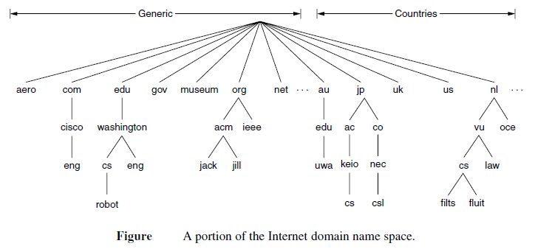
How DNS works
When we search for www.amazon.com in the browser the domain name gets mapped with the IP address using the hierarchical architecture
STEP-I : the request will be sent to the root server . there are 2 methods for this recursive method and iterative method

Slide 134
STEP-II:To map a name onto an IP address, an application program calls a library procedure called the resolver is used to resolve the domain name into an IP address
STEP-III: The Root Server will provide the IP address of next level (generic server or country server) to the resolver
STEP-IV: The resolving is done from right to left and the request will be forwarded to .com server to distribute the traffic there are multiple servers in .com server for load balancing
STEP-V: The request is forwarded to Authoritative Server where it stores the IP address of several domain names this IP address is given to the resolver then to the browser

Slide 135
Although every time we don’t require this process because the ISP(Internet Service Provider) stores the value in the cache memory
We use DNS process only when we are searching any website for the first time
DNS uses UDP protocol

Slide 137
HTTP—The HyperText Transfer Protocol
BY
Mrs. E. Himabindu
Asst. Professor
SVIT

Slide 138
HTTP Basics:
HTTP (HyperText Transfer Protocol) serves as the foundation of data communication on the World Wide Web. It enables the exchange of information between web clients (browsers) and web servers. HTTP operates as a simple request-response protocol over TCP/IP, facilitating the retrieval and transmission of web content.

Slide 139
HTTP Methods:
HTTP supports several methods that dictate how clients and servers interact.
The GET method is used to request content, like web pages, images, or files.
HEAD method requests headers only, often used for checking resource existence or validity.
POST method sends data to the server, usually used for submitting forms or updating resources.
PUT method allows clients to store or update a resource at a specific URL.
DELETE method is used to request the removal of a resource.
Other methods include TRACE (used for diagnostic purposes), CONNECT (for proxy connections), and OPTIONS (to query supported methods).

Slide 140
HTTP Status Codes:
HTTP responses are accompanied by status codes indicating the outcome of a request. Status codes help clients understand whether their requests were successful or encountered issues. Examples of status codes: 200 OK (successful request), 404 Not Found (resource not available), 500 Internal Server Error (server issue).

Slide 141
HTTP Headers:
HTTP headers are metadata included in both requests and responses to provide additional context.
The User-Agent header identifies the client software (browser) making the request.
The Accept header specifies the preferred content types that the client can handle.
Cache-Control header controls caching behavior, such as no-cache or max-age for freshness duration.
Referer header indicates the URL of the page that led the client to request the current resource.
Cookies are managed using Set-Cookie (server sets cookies) and Cookie (client sends cookies) headers.

Slide 142
HTTP Connections:
Initially, HTTP 1.0 used separate connections for each request, incurring overhead due to TCP connection setup.
HTTP 1.1 introduced persistent connections, allowing multiple requests and responses over a single connection.
Persistent connections improve performance by reducing the overhead of repeated connection setup and teardown.

Slide 144
Caching:
Caching is a technique to store copies of resources locally to reduce network latency and server load. Cached resources can be validated using the Expires header (defines expiration time) and If-Modified-Since header (conditional GET). ETag headers provide unique identifiers for cached resources, enabling efficient validation using If-None-Match headers.

Slide 146
Proxy Caching
Proxy caching involves intermediary servers (proxies) storing cached copies of resources to serve multiple clients. Proxy caches enhance performance by minimizing repeated requests to origin servers, improving response times for clients.

Slide 147
SNMP Protocol
By
Mrs. E. Himabindu
Asst. Professor
SVIT

Slide 148
SNMP Protocol
Simple Network Management Protocol is an application layer protocol defined by the Internet Architecture Board in RFC 1157. SNMP protocol is used to exchange management information between network devices. It is one of the most widely used protocols for network management. SNMP is used to monitor the network, detect network faults, and sometimes even used to configure remote devices.

Slide 149
3 components of SNMP
SNMP Manager – It is a centralized system used to monitor network. It is also known as Network Management Station (NMS)
SNMP agent – It is a software management software module installed on a managed device. Managed devices can be network devices like PC, routers, switches, servers, etc.
Management Information Base – MIB consists of information on resources that are to be managed. This information is organized hierarchically. It consists of objects instances which are essentially variables.

Slide 150
SNMP messages
GetRequest
GetNextRequest
GetBulkRequest
SetRequest
Response
Trap
InformRequest

Slide 151
SNMP works by sending protocol data units, also known as SNMP GET requests, to network devices that respond to SNMP. All these communications are tracked, and network monitoring tools use GET requests to fetch data from SNMP. Traffic flows into your network from different sources. Simple Network Management Protocol communicates with the whole network and the devices in it.

Slide 153
SNMP versions
There are 3 versions of SNMP: SNMPv1 – It uses community strings for authentication and uses UDP only. SNMPv2c – It uses community strings for authentication. It uses UDP but can be configured to use TCP. SNMPv3 – It uses Hash-based MAC with MD5 or SHA for authentication and DES-56 for privacy. This version uses TCP. Therefore, the conclusion is the higher the version of SNMP, the more secure it will be.

Slide 154
Strength of SNMP
It is simple to implement.
Agents are widely implemented.
Agent level overhead is minimal.
It is robust and extensible.
Polling approach is good for LAN based managed object.
It offers the best direct manager agent interface.
SNMP meet a critical need.

Slide 155
Limitation of SNMP
It is too simple and does not scale well.
There is no object orietned data view.
It has no standard control definition.
It has many implementation specific (private MIB) extensions.
It has high communication overhead due to polling

Slide 156
Thank You

