Slide 1
Introduction to Compiler Construction
Lecture 1

Slide 2
Compiler
A given source language is either compiled or interpreted for execution
compiler is a program that translates a source program (HLL; C, Java) into target code; machine re-locatable code or assembly code.
  The generated machine code can be later executed many times against different data each time.
  The code generated is not portable to other systems.

Slide 3
Interpreter
In an interpreted language, implementations execute instructions directly and freely without previously compiling a program into machine code instructions.
Translation occurs at the same time as the program is being executed.
An interpreter reads an executable source program written in HLL as well as data for this program, and it runs the program against the data to produce some results.

Slide 4
Interpreter
Common interpreters include Perl, Python, and Ruby interpreters, which execute Perl, Python, and Ruby code respectively.
Others include Unix shell interpreter, which runs operating system commands interactively.
Source program is interpreted every time it is executed (less efficient).

Slide 5
Interpreter
Interpreted languages are portable since they are not machine dependent. They can run on different operating systems and platforms.
They are translated on the spot and thus optimized for the system on which they’re being run.

Slide 6
Compilers and Interpreters
“Compilation”
  Translation of a program written in a source language into a semantically equivalent program written in a target language
Input
Source
Program
Compiler
Target
Program
Error messages
Output

Slide 7
Compilers and Interpreters (cont’d)
“Interpretation”
  Performing the operations implied by the source program
Source
Program
Interpreter
Output
Input
Error messages

Slide 8
The Analysis-Synthesis Model of Compilation
There are two parts to compilation:
  Analysis Phase
This is also known as the front-end of the compiler. It reads the source program, divides it into core parts and then checks for lexical, grammar and syntax errors. The analysis phase generates an intermediate representation of the source program and symbol table, which should be fed to the Synthesis phase as input
  Synthesis Phase
Its also known as the back-end of the compiler.
It generates the target program with the help of intermediate source code representation and symbol table.

Slide 9
Other Tools that Use the Analysis-Synthesis Model
Editors (syntax highlighting)
Pretty printers (e.g. Doxygen)
Static checkers (e.g. Lint and Splint)
Interpreters
Text formatters (e.g. TeX and LaTeX)
Silicon compilers (e.g. VHDL)
Query interpreters/compilers (Databases)

Slide 10
Preprocessors, Compilers, Assemblers and Linkers
A preprocessor considered as part of compiler, is a tool that produces input for compilers. It deals with macro-processing, file inclusion, language extension, etc.
Assembler
An assembler translates assembly language programs into machine code. The output of an assembler is called an object file, which contains a combination of machine instructions as well as the data required to place these instructions in memory.

Slide 11
Preprocessors, Compilers, Assemblers and Linkers
Linker
A computer program that links and merges various object files together in order to make an executable file.
All these files might have been compiled by separate assemblers. The major task of a linker is to search and locate referenced module/routines in a program and to determine the memory location where these codes will be loaded, making the program instruction to have absolute references.

Slide 12
Compiler Design - Architecture of a Compiler
A compiler can have many phases and passes.
Pass : A pass refers to the traversal of a compiler through the entire program.
Phase : A phase of a compiler is a distinguishable stage, which takes input from the previous stage, processes and yields output that can be used as input for the next stage. A pass can have more than one phase.

Slide 13
Phases of a Compiler
The compilation process is a sequence of various phases.
Each phase takes input from its previous stage and has its own representation of source program, and feeds its output to the next phase of the compiler.

Slide 14
Traditional three pass compiler
Source
code
Front end
IR
Middle
end
IR
Back end
Machine
code
errors

Slide 15
Phases of a Compiler - Front end
The front end analyzes the source code to build an internal representation of the program, called the intermediate representation (IR).
It also manages the symbol table, a data structure mapping each symbol in the source code to associated information such as location, type and scope.

Slide 16
Phases of a Compiler - Front end cont’d
The front end includes all analysis phases and the intermediate code generator.
Lexical analysis is the first phase of compiler which is also termed as scanning.
During this phase, Source program is scanned to read the stream of characters and those characters are grouped to form a sequence called lexemes which produces token as output. Tokens are defined by regular expressions which are understood by the lexical analyzer.

Slide 17
Lexical Analysis
lexical analysis: The process of converting a sequence of characters (such as in a computer program) into a sequence of tokens (strings with an identified "meaning")
Lexical analysis takes the modified source code from language preprocessors that are written in the form of sentences.
The lexical analyzer breaks these syntaxes into a series of tokens, by removing any whitespace or comments in the source code.

Slide 18
Lexical Analysis
The lexical analyzer (either generated automatically by a tool like lex, or hand-crafted) reads in a stream of characters, identifies the lexemes in the stream, and categorizes them into tokens.
This is called "tokenizing". If the lexer finds an invalid token, it will report an error.

Slide 19
Front end: Terminologies
Token: Token is a sequence of characters that represent lexical unit, which matches with the pattern, such as keywords, operators, identifiers etc.
Lexeme: Lexeme is instance of a token i.e., group of characters forming a token.
Pattern: Pattern describes the rule that the lexemes of a token takes. It is the structure that must be matched by strings.

Slide 20
Token and Lexeme
Once a token is generated the corresponding entry is made in the symbol table.
At lexical analysis phase,
Input: stream of characters
Output: Token
Token Template:
<token-name, attribute-value>
For example, for c=a+b*5;
Hence,
<id, 1><=>< id, 2>< +><id, 3 >< * >< 5>

Slide 21
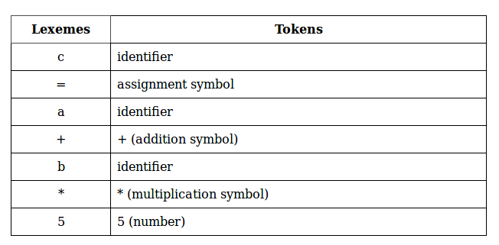
Token and Lexeme Cont’d

Slide 22
Syntax Analysis
Syntax Analyze is sometimes called as parser. It constructs the parse tree. It takes all the tokens one by one and uses Context Free Grammar to construct the parse tree.
Why Grammar ?
The rules of programming can be entirely represented in some few productions. Using these productions we can represent what the program actually is. The input has to be checked whether it is in the desired format or not.

Slide 23
Syntax Analysis cont’d
Syntax error can be detected at this level if the input is not in accordance with the grammar.

Slide 24
Syntactic Analysis
Parsing or syntactic analysis is the process of analyzing a string of symbols, either in natural language or in computer languages, conforming to the rules of a formal grammar
Parse: analyze (a string or text) into logical syntactic components, typically in order to test conformability to a logical grammar.

Slide 25
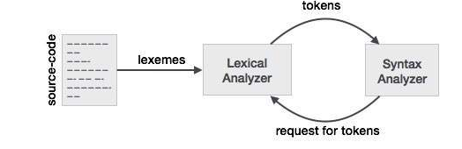
Syntactic Analysis cont’d
If the lexical analyzer finds a token invalid, it generates an error.
The lexical analyzer works closely with the syntax analyzer. It reads character streams from the source code, checks for legal tokens, and passes the data to the syntax analyzer when it demands.

Slide 26
Semantic Analysis
Semantic analyzer takes the output of syntax analyzer and produces another tree.
Similarly, intermediate code generator takes a tree as an input produced by semantic analyzer and produces intermediate code.

Slide 27
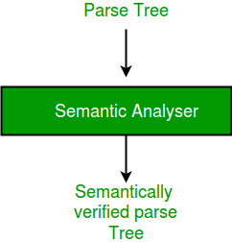
Semantic Analyzer

Slide 28
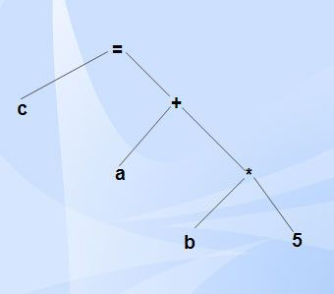
Semantic Analysis cont’d
Syntax tree is a compressed representation of the parse tree (a hierarchical structure that represents the derivation of the grammar to obtain input strings) in which the operators appear as interior nodes and the operands of the operator are the children of the node for that operator.
Example of syntax tree

Slide 29
Semantic Analyzer
Semantic analysis is the third phase of compiler.
It checks for the semantic consistency.
Type information is gathered and stored in symbol table or in syntax tree.
Performs type checking.
It verifies the parse tree, whether it’s meaningful or not. It furthermore produces a verified parse tree.

Slide 30
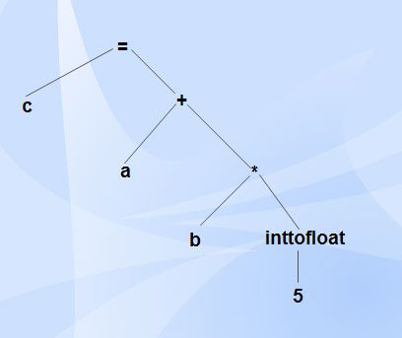
Semantic Analyzer

Slide 31
Front-end, Back-end division
Source
code
Front end
IR
Back end
Machine
code
errors
Front end maps legal code into IR
Back end maps IR onto target machine
Allows multiple front ends
Multiple passes -> better code

Slide 32
Front end
Source
code
Scanner
tokens
Parser
IR
errors
Recognize legal code
Report errors
Produce IR
Preliminary storage maps

Slide 33
Front end
Source
code
Scanner
tokens
Parser
IR
errors
Scanner:
  Maps characters into tokens – the basic unit of syntax
    x = x + y becomes <id, x> = <id, x> + <id, y>
  Typical tokens: number, id, +, -, *, /, do, end
  Eliminate white space (tabs, blanks, comments)
A key issue is speed so instead of using a tool like LEX it sometimes needed to write your own scanner

Slide 34
Front end
Source
code
Scanner
tokens
Parser
IR
errors
Parser:
  Recognize context-free syntax
  Guide context-sensitive analysis
  Construct IR
  Produce meaningful error messages
  Attempt error correction
There are parser generators like YACC which automates much of the work

Slide 35
Phases of a Compiler cont’d
Middle End – The Optimizer
The middle end performs optimizations on the intermediate representation in order to improve the performance and the quality of the produced machine code.
The middle end contains those optimizations that are independent of the CPU architecture being targeted.
  Effort to realize efficiency
  Can be very computationally intensive

Slide 36
Middle end (optimizer)
Modern optimizers are usually built as a set of passes
Typical passes
  Constant propagation
  Common sub-expression elimination
  Redundant store elimination
  Dead code elimination

Slide 37
Back end
Instruction
selection
Register
Allocation
Machine code
IR
errors
Translate IR into target machine code
Choose instructions for each IR operation
Decide what to keep in registers at each point
Ensure conformance with system interfaces

Slide 38
Phases of a Compiler
Back End – This is responsible for the CPU architecture specific optimizations and for code generation.
Machine dependent optimizations: optimizations that depend on the details of the CPU architecture that the compiler targets
Code generation. The transformed intermediate language is translated into the output language, usually the native machine language of the system.

Slide 39
Phases of a Compiler
It also involves resource and storage decisions, such as; deciding which variables to fit into registers and memory and the selection and scheduling of appropriate machine instructions along with their associated addressing modes
  Processor (target) Dependant optimization

Slide 40
Phases of a Compiler - Instruction selection
Instruction selection is the stage of a compiler back-end that transforms its middle-level intermediate representation (IR) into a low-level IR where each operation directly corresponds to an instruction available on the target machine.
In a typical compiler, instruction selection precedes both instruction scheduling and register allocation; hence its output IR has an infinite set of pseudo-registers

Slide 41
Back end
Instruction
selection
Register
Allocation
Machine code
IR
errors
Have a value in a register when used
Limited resources
Optimal allocation is difficult

Slide 42
Intermediate Code Generation
After semantic analysis the compiler generates an intermediate code of the source code for the target machine.
  It represents a program for some abstract machine.
  It is in between the high-level language and the machine language.
  This intermediate code should be generated in such a way that it makes it easier to be translated into the target machine code.

Slide 43
Code Optimization
Optimization can be assumed as something that removes unnecessary code lines, and arranges the sequence of statements in order to speed up the program execution without wasting resources (CPU, memory).

Slide 44
Code Generation
In this phase, the code generator takes the optimized representation of the intermediate code and maps it to the target machine language.
The code generator translates the intermediate code into a sequence of (generally) re-locatable machine code. Sequence of instructions of machine code performs the task as the intermediate code would do.

Slide 45
Symbol Table
It is a data-structure maintained throughout all the phases of a compiler.
All the identifier's names along with their types are stored here.
The symbol table makes it easier for the compiler to quickly search the identifier record and retrieve it. The symbol table is also used for scope management.

Slide 46
Compiler-Construction Tools
Software development tools are available to implement one or more compiler phases
  Scanner generators
  Parser generators
  Syntax-directed translation engines
  Automatic code generators
  Data-flow engines

Slide 47
Lexical Analysis

Slide 48
Review
What is a compiler?
What are the Phases of a Compiler?

Slide 49
The Goals of Chapter 3
See how to construct a lexical analyzer
  Lexeme description
  Code to recognize lexemes
Lexical Analyzer Generator
  Lex and Flex
Regular Expressions
  To Nondeterministic finite autamota
  To Finite Automata
  Then to Code

Slide 50
What is a Lexical Analyzer supposed to do?
Read the input characters of the source program,
Group them into lexemes,
  Check with the symbol table regarding this lexeme
Produce as output a sequence of tokens
  This stream is sent to the parser

Slide 51
What is a Lexical Analyzer supposed to do?
It may also
  strip out comments and whitespace.
  Keep track of line numbers in the source file (for error messages)

Slide 52
Terms
Token
  A pair (token name, [attribute value])
  Ex: (integer, 32)
Pattern
  A description of the form the lexemes will take
  Ex: regular expressions
Lexeme
  An instance matched by the pattern.

Slide 53
What are the tokens?
Code:
  printf(“Total= %d\n”, score);
Tokens:
  (id, printf)
  openParen
  literal “Total= %d\n”
  comma
  (id, score)
  closeParen
  semicolon

Slide 54
Token Attributes
When more than one lexeme can match a pattern, the lexical analyzer must provide the next phase additional information.
  Number – needs a value
  Id – needs the identifier name, or probably a symbol table pointer

Slide 55
Specification of Tokens
Regular expressions are an important notation for specifying lexeme patterns.
We are going to
  first study the formal notation for a regular expression
  Then we will show how to build a lexical analyzer that uses regular expressions.
  Then we will see how they are used in a lexical analyzer.

Slide 56
Buffering
In principle, the analyzer goes through the source string a character at a time;
In practice, it must be able to access substrings of the source.
Hence the source is normally read into a buffer
The scanner needs two subscripts to note places in the buffer
  lexeme start & current position

Slide 57
Strings and Alphabets
Def: Alphabet – a finite set of symbols
  Typically letters, digits, and punctuation
Example:
  {0,1} is a binary alphabet.

Slide 58
Strings and Alphabets
Def: String – (over an alphabet) is a finite sequence of symbols drawn from that alphabet.
  Sometimes called a “word”
  The empty string ε

Slide 59
Strings and Alphabets
Def: Language – any countable set of strings over some fixed alphabet.
Notes:
  Abstract languages like ∅, and {ε} fit this definition, but so also do C programs
  This definition also does not require any meaning – that will come later.

Slide 60
Finite State Automata
The compiler writer defines tokens in the language by means of regular expressions.
Informally a regular expression is a compact notation that indicates what characters may go together into lexemes belonging to that particular token and how they go together.
We will see regular expressions later

Slide 61
The lexical analyzer is best implemented as a finite state machine or a finite state automaton.
Informally a Finite-State Automaton is a system that has a finite set of states with rules for making transitions between states.
The goal now is to explain these two things in detail and bridge the gap from the first to the second.

Slide 62
State Diagrams and State Tables
Def: State Diagram -- is a directed graph where the vertices in the graph represent states, and the edges indicate transitions between the states.
Let’s consider a vending machine that sells candy bars for 25 cents, and it takes nickels, dimes, and quarters.

Slide 63
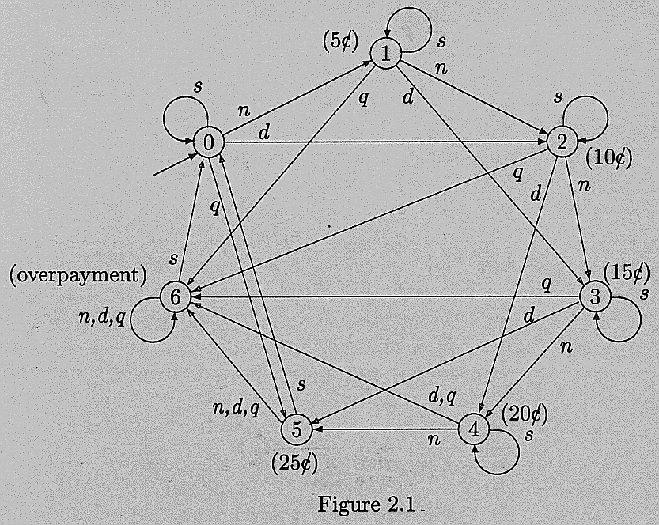
Figure 2.1 -- pg.. 21

Slide 64
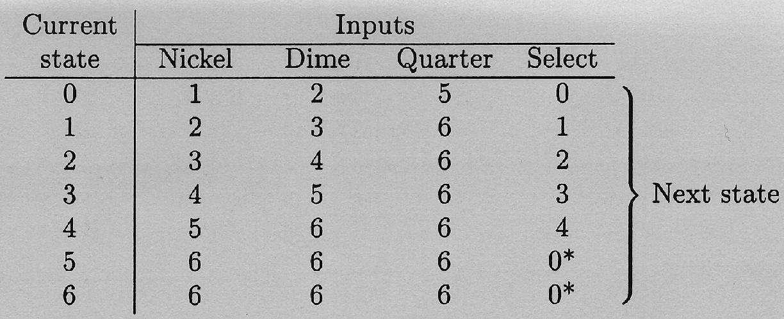
Def: State Table -- is a table with states down the left side, inputs across the top, and row/column values indicate the current state/input and what state to go to.

Slide 65
Formal Definition
Def: FSA -- A FSA, M consists of
  a finite set of input symbols Σ (the input alphabet)
  a finite set of states Q
  A starting state q₀ (which is an element of Q)
  A set of accepting states F (a subset of Q) (these are sometimes called final states)
  A state-transition function N: (Q x Σ) -> Q
M = (Σ, Q, q₀, F, N)

Slide 66
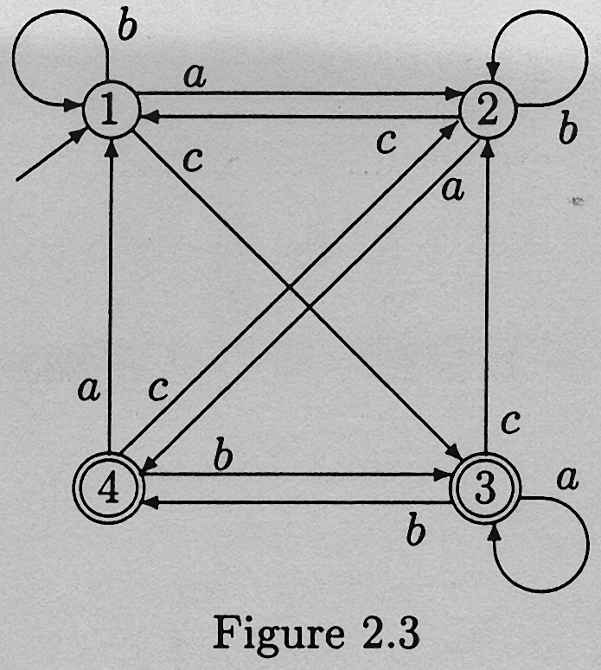
Example 1:
  Given Machine Construct Table:

Slide 67
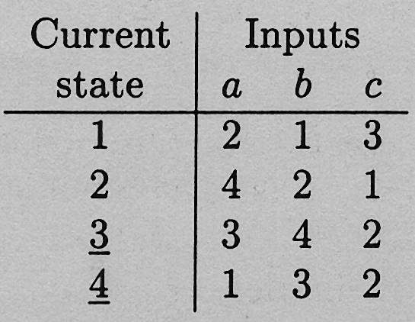

Slide 68
Example 1 (cont.):
  State 1 is the Starting State. This is shown by the arrow in the Machine, and the fact that it is the first state in the table.
  States 3 and 4 are the accepting states. This is shown by the double circles in the machine, and the fact that they are underlined in the table.

Slide 69
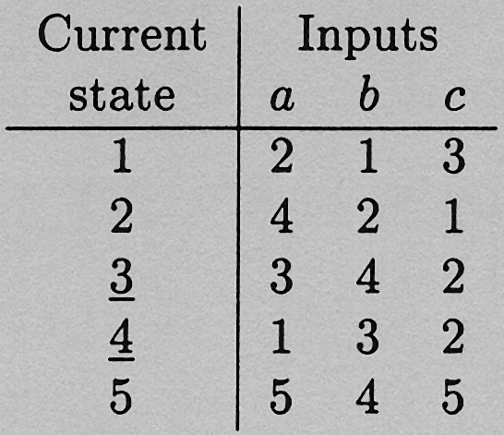
Example 2:
  Given Table, Construct Machine:

Slide 70
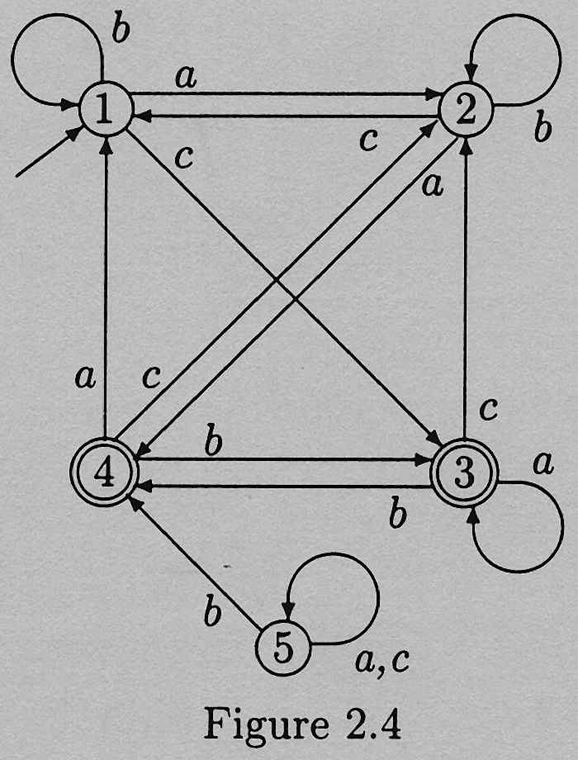

Slide 71
Example 2 (cont.):
  This machine shows that it is entirely possible to have unreachable states in an automaton.
  These states can be removed without affecting the automaton.

Slide 72
Acceptance
We use FSA's for recognizing tokens
A character string is recognized (or accepted) by FSA M if, when the last character has been read, M is in one of the accepting states.
  If we pass through an accepting state, but end in a non-accepting state, the string is NOT accepted.

Slide 73
Def: language -- A language is any set of strings.
Def: a language over an alphabet Σ is any set of strings made up only of the characters from Σ
Def: L(M) -- the language accepted by M is the set of all strings over Σ that are accepted by M

Slide 74
if we have an FSA for every token, then the language accepted by that FSA is the set of all lexemes embraced by that token.
Def: equivalent -- M1 == M2 iff L(M1) = L(M2).

Slide 75
A FSA can be easily programmed if the state table is stored in memory as a two-dimensional array. table : array[1..nstates,1..ninputs] of byte;
Given an input string w, the code would look something like this: state := 1; for i:=1 to length(w) do begin col:= char_to_col(w[i]); state:= table[state, col] end;

Slide 76
Nondeterministic Finite-State Automata
So far, the behavior of our FSAs has always been predictable. But there is another type of FSA in which the state transitions are not predictable.
In these machines, the state transition function is of the form: N: Q x (Σ U {ε}) -> P(Q)
  Note: some authors use a Greek lambda, λ or Λ

Slide 77
This means two things:
  There can be transitions without input. (That is why the ε is in the domain)
  Input can transition to a number of states. (That is the significance of the power set in the codomain)

Slide 78
Since this makes the behavior unpredictable, we call it a nondeterministic FSA
  So now we have DFAs and NFAs (or NDFAs)
a string is accepted if there is at least 1 path from the start state to an accepting state.

Slide 79
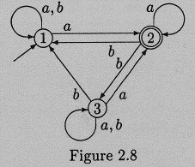
Example: Given Machine Trace the input = baabab

Slide 80
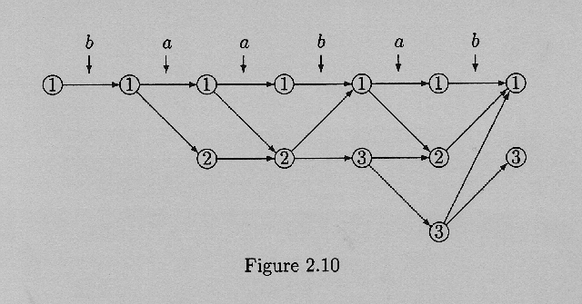

Slide 81
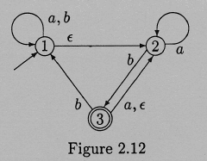
ε-Transitions
a spontaneous transition without input.
Example: Trace input aaba

Slide 82
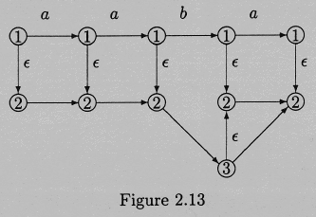

Slide 83
Equivalence
For every non-deterministic machine M we can construct an equivalent deterministic machine M'
Therefore, why study N-FSA?
  1.Theory.
  2.Tokens -> Reg.Expr. -> N-FSA -> D-FSA

Slide 84
The Subset Construction
Constructing an equivalent DFA from a given NFA hinges on the fact that transitions between state sets are deterministic even if the transitions between states are not.
Acceptance states of the subset machine are those subsets that contain at least 1 accepting state.

Slide 85
Generic brute force construction is impractical.
  As the number of states in M increases, the number of states in M' increases drastically (n vs. 2^{n}). If we have a NFA with 20 states |P(Q)| is something over a million.
  This also leads to the creation of many unreachable states. (which can be omitted)
The trick is to only create subset states as you need them.

Slide 86
Example:
  Given: NFA
  Build DFA out of NFA

Slide 87
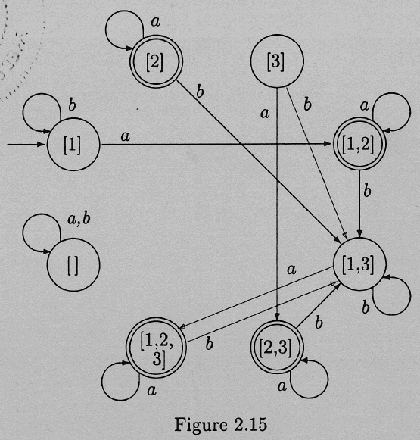

Slide 88
Why do we care?
Lexical Analysis and Syntactic Analysis are typically run off of tables.
These tables are large and laborious to build.
Therefore, we use a program to build the tables.

Slide 89
But there are two major problems:
  How do we represent a token for the table generating program?
  How does the program convert this into the corresponding FSA?
Tokens are described using regular expressions.

Slide 91
Regular Expressions
Informally a regular expression of an alphabet Σ is a combination of characters from Σ and certain operators indicating concatenation, selection, or repetition.
  b* -- 0 or more b's (Kleene Star)
  b⁺ -- 1 or more b's
  | -- a|b -- choice

Slide 92
Regular Expressions
Def: Regular Expression:
  any character in Σ is an RE
  ε is an RE
  if R and S are RE's so are RS, R|S, R*, R⁺, S*, S⁺.
Only expressions formed by these rules are regular.

Slide 93
Regular Expressions
REs can be used to describe only a limited variety of languages, but they are powerful enough to be used to define tokens.
One limitation -- many languages put length limitations on their tokens, RE's have no means of enforcing such limitations.

Slide 94
Extensions to REs
One or more Instances +
Zero or One Instance ?
Character Classes
  Digit -> [0-9]
  Digits -> Digit+
  Number -> Digits (. Digits)? (E [+-]? Digits)?

Slide 95

Regular Expressions and Finite-State Machines
This machine recognizes ε

Slide 96

This machine will recognize a character a in Σ

Slide 97

To recognize RS connect the machines as shown

Slide 98
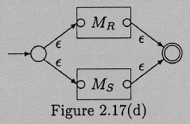
To recognize R|S, connect the machines this way.

Slide 99
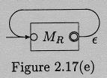
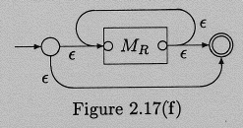
R*
  Begin with R⁺
  Now add the zero or more to go from R⁺ to R*

Slide 100
The Pumping Lemma
Given a machine with n states
and a string w in L(M) has length n
w must go through n+1 states, therefore something is repeated (call it y)
therefore w = xyz and y can be looped.
so xy*z is also part of the language.

Slide 101
The goal of the pumping lemma is to show that there are some languages that are not regular.
For Example:
  L_{R} = {wcw^{R} | w in (0,1)*}
  L_{P} -- matching parens
    this is handled in syntax analysis.

Slide 102
Application to Lexical Analysis
Now you are ready to put it all together:
  Given 2 tokens' regular expression
    X = aa*(b|c)
    Y = (b|c)c*
  Construct the NDFA
  Construct the DFA

Slide 103
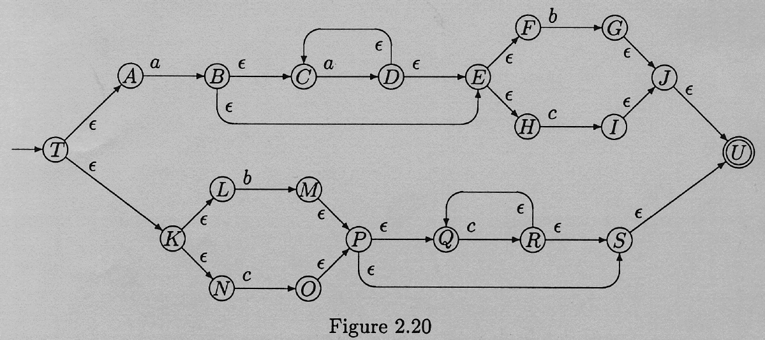

Slide 104
Recognizing Tokens
The scanner must ignore white space (except to note the end of a token)
  Add white space transition from Start state to Start state.
When you enter an accept state, announce it
  (therefore you cannot pass through accept states)
  The string may be the entire program.

Slide 105
One accept state for each token, so we know what we found.
Identifier/Keyword differences
  Accept everything as an identifier, and then look up keywords in table. Or pre-load the Symbol Table with Keywords.
When you read an identifier, you read the next character in order to tell it was the end. You need to back up (put it back on the input stream).

Slide 106
Comments
  Recognize the beginning of comment, and then ignore everything until the end of comment.
  What if there are multiple types of comments?
Character Strings
  single or double quotes?

Slide 107
Compiler course
Chapter 4
Syntax Analysis

Slide 108
Outline
Role of parser
Context free grammars
Top down parsing
Bottom up parsing
Parser generators

Slide 109
The role of parser
token
Source
program
Lexical Analyzer
Parser
Parse tree
Rest of Front End
Intermediate
representation
getNext
Token
Symbol
table

Slide 110
Uses of grammars
E -> E + T | T
T -> T * F | F
F -> (E) | id
E -> TE’
E’ -> +TE’ | Ɛ
T -> FT’
T’ -> *FT’ | Ɛ
F -> (E) | id

Slide 111
Error handling
Common programming errors
  Lexical errors
  Syntactic errors
  Semantic errors
  Lexical errors
Error handler goals
  Report the presence of errors clearly and accurately
  Recover from each error quickly enough to detect subsequent errors
  Add minimal overhead to the processing of correct progrms

Slide 112
Error-recover strategies
Panic mode recovery
  Discard input symbol one at a time until one of designated set of synchronization tokens is found
Phrase level recovery
  Replacing a prefix of remaining input by some string that allows the parser to continue
Error productions
  Augment the grammar with productions that generate the erroneous constructs
Global correction
  Choosing minimal sequence of changes to obtain a globally least-cost correction

Slide 113
Context free grammars
Terminals
Nonterminals
Start symbol
productions
expression -> expression + term
expression -> expression – term
expression -> term
term -> term * factor
term -> term / factor
term -> factor
factor -> (expression)
factor -> id

Slide 114
Derivations
Productions are treated as rewriting rules to generate a string
Rightmost and leftmost derivations
  E -> E + E | E * E | -E | (E) | id
  Derivations for –(id+id)
    E => -E => -(E) => -(E+E) => -(id+E)=>-(id+id)

Slide 115
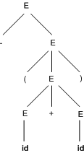
Parse trees
-(id+id)
    E => -E => -(E) => -(E+E) => -(id+E)=>-(id+id)

Slide 116
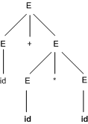
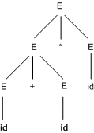
Ambiguity
For some strings there exist more than one parse tree
Or more than one leftmost derivation
Or more than one rightmost derivation
Example: id+id*id

Slide 117

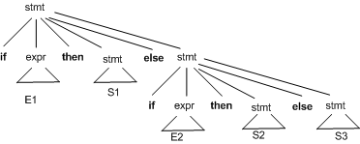
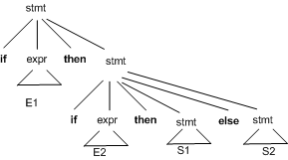
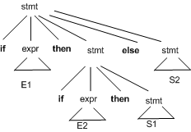
Elimination of ambiguity

Slide 118
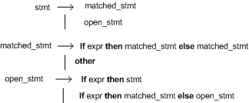
Elimination of ambiguity (cont.)
Idea:
  A statement appearing between a then and an else must be matched

Slide 119
Elimination of left recursion
A grammar is left recursive if it has a non-terminal A such that there is a derivation A=> Aα
Top down parsing methods cant handle left-recursive grammars
A simple rule for direct left recursion elimination:
  For a rule like:
    A -> A α|β
  We may replace it with
    A -> β A’
    A’ -> α A’ | ɛ
+

Slide 120
Left recursion elimination (cont.)
There are cases like following
  S -> Aa | b
  A -> Ac | Sd | ɛ
Left recursion elimination algorithm:
  Arrange the nonterminals in some order A1,A2,…,An.
  For (each i from 1 to n) {
    For (each j from 1 to i-1) {
      Replace each production of the form Ai-> Aj γ by the production Ai -> δ1 γ | δ2 γ | … |δk γ where Aj-> δ1 | δ2 | … |δk are all current Aj productions
      }
      Eliminate left recursion among the Ai-productions
    }

Slide 121
Left factoring
Left factoring is a grammar transformation that is useful for producing a grammar suitable for predictive or top-down parsing.
Consider following grammar:
  Stmt -> if expr then stmt else stmt
  | if expr then stmt
On seeing input if it is not clear for the parser which production to use
We can easily perform left factoring:
  If we have A->αβ1 | αβ2 then we replace it with
    A -> αA’
    A’ -> β1 | β2

Slide 122
Left factoring (cont.)
Algorithm
  For each non-terminal A, find the longest prefix α common to two or more of its alternatives. If α<> ɛ, then replace all of A-productions A->αβ1 |αβ2 | … | αβn | γ by
    A -> αA’ | γ
    A’ -> β1 |β2 | … | βn
Example:
  S -> I E t S | i E t S e S | a
  E -> b

Slide 123
Top Down Parsing

Slide 124
Introduction
A Top-down parser tries to create a parse tree from the root towards the leafs scanning input from left to right
It can be also viewed as finding a leftmost derivation for an input string
Example: id+id*id
E -> TE’
E’ -> +TE’ | Ɛ
T -> FT’
T’ -> *FT’ | Ɛ
F -> (E) | id
E
E
E
E
E
E
lm
lm
lm
lm
lm
T
E’
T
E’
T
E’
T
E’
T
E’
F
T’
F
T’
F
T’
F
T’
+
T
E’
id
id
Ɛ
id
Ɛ

Slide 125
Recursive descent parsing
Consists of a set of procedures, one for each nonterminal
Execution begins with the procedure for start symbol
A typical procedure for a non-terminal
void A() {
choose an A-production, A->X1X2..Xk
for (i=1 to k) {
if (Xi is a nonterminal
call procedure Xi();
else if (Xi equals the current input symbol a)
advance the input to the next symbol;
else /* an error has occurred */
}
}

Slide 126
Recursive descent parsing (cont)
General recursive descent may require backtracking
The previous code needs to be modified to allow backtracking
In general form it cant choose an A-production easily.
So we need to try all alternatives
If one failed the input pointer needs to be reset and another alternative should be tried
Recursive descent parsers cant be used for left-recursive grammars

Slide 127
Example
S->cAd
A->ab | a
Input: cad
S
S
S
c
A
d
c
A
d
c
A
d
a
b
a

Slide 128
First and Follow
First() is set of terminals that begins strings derived from
If α=>ɛ then is also in First(ɛ)
    In predictive parsing when we have A-> α|β, if First(α) and First(β) are disjoint sets then we can select appropriate A-production by looking at the next input
Follow(A), for any nonterminal A, is set of terminals a that can appear immediately after A in some sentential form
  If we have S => αAaβ for some αand βthen a is in Follow(A)
If A can be the rightmost symbol in some sentential form, then $ is in Follow(A)
*
*

Slide 129
Computing First
To compute First(X) for all grammar symbols X, apply following rules until no more terminals or ɛ can be added to any First set:
  If X is a terminal then First(X) = {X}.
  If X is a nonterminal and X->Y1Y2…Yk is a production for some k>=1, then place a in First(X) if for some i a is in First(Yi) and ɛ is in all of First(Y1),…,First(Yi-1) that is Y1…Yi-1 => ɛ. if ɛ is in First(Yj) for j=1,…,k then add ɛ to First(X).
  If X-> ɛ is a production then add ɛ to First(X)
Example!
*
*

Slide 130
Computing follow
To compute First(A) for all nonterminals A, apply following rules until nothing can be added to any follow set:
  Place $ in Follow(S) where S is the start symbol
  If there is a production A-> αBβ then everything in First(β) except ɛ is in Follow(B).
  If there is a production A->B or a production A->αBβ where First(β) contains ɛ, then everything in Follow(A) is in Follow(B)
Example!

Slide 131
LL(1) Grammars
Predictive parsers are those recursive descent parsers needing no backtracking
Grammars for which we can create predictive parsers are called LL(1)
  The first L means scanning input from left to right
  The second L means leftmost derivation
  And 1 stands for using one input symbol for lookahead
A grammar G is LL(1) if and only if whenever A-> α|βare two distinct productions of G, the following conditions hold:
  For no terminal a do αandβ both derive strings beginning with a
  At most one of α or βcan derive empty string
  If α=> ɛ then βdoes not derive any string beginning with a terminal in Follow(A).
*

Slide 132
Construction of predictive parsing table
For each production A->α in grammar do the following:
  For each terminal a in First(α) add A-> in M[A,a]
  If ɛ is in First(α), then for each terminal b in Follow(A) add A-> ɛ to M[A,b]. If ɛ is in First(α) and $ is in Follow(A), add A-> ɛ to M[A,$] as well
If after performing the above, there is no production in M[A,a] then set M[A,a] to error

Slide 133
Example
First
Follow
F
T
E
E’
T’
{(,id}
{+, *, ), $}
E -> TE’
E’ -> +TE’ | Ɛ
T -> FT’
T’ -> *FT’ | Ɛ
F -> (E) | id
{(,id}
{+, ), $}
{(,id}
{), $}
{+,ɛ}
{), $}
{*,ɛ}
{+, ), $}
Input Symbol
Non -
terminal
id
+
*
(
)
$
E
E’
T
T’
F
E -> TE’
E -> TE’
E’ -> +TE’
E’ -> Ɛ
E’ -> Ɛ
T -> FT’
T -> FT’
T’ -> Ɛ
T’ -> *FT’
T’ -> Ɛ
T’ -> Ɛ
F -> id
F -> (E)

Slide 134
Another example
S -> iEtSS’ | a
S’ -> eS | Ɛ
E -> b
Input Symbol
Non -
terminal
a
b
e
i
t
$
S
S’
E
S -> a
S -> iEtSS’
S’ -> Ɛ
S’ -> eS
S’ -> Ɛ
E -> b

Slide 135
Non-recursive predicting parsing
a
+
b
$
Predictive
parsing
program
output
stack
X
Y
Z
$
Parsing
Table
M

Slide 136
Predictive parsing algorithm
Set ip point to the first symbol of w;
Set X to the top stack symbol;
While (X<>$) { /* stack is not empty */
if (X is a) pop the stack and advance ip;
else if (X is a terminal) error();
else if (M[X,a] is an error entry) error();
else if (M[X,a] = X->Y1Y2..Yk) {
output the production X->Y1Y2..Yk;
pop the stack;
push Yk,…,Y2,Y1 on to the stack with Y1 on top;
}
set X to the top stack symbol;
}

Slide 137
Example
id+id*id$
Matched
Stack
Input
Action
E$
id+id*id$

Slide 138
Error recovery in predictive parsing
Panic mode
  Place all symbols in Follow(A) into synchronization set for nonterminal A: skip tokens until an element of Follow(A) is seen and pop A from stack.
  Add to the synchronization set of lower level construct the symbols that begin higher level constructs
  Add symbols in First(A) to the synchronization set of nonterminal A
  If a nonterminal can generate the empty string then the production deriving can be used as a default
  If a terminal on top of the stack cannot be matched, pop the terminal, issue a message saying that the terminal was insterted

Slide 139
Example
Non -
terminal
Input Symbol
id
+
*
(
)
$
E
E’
T
T’
F
E -> TE’
E -> TE’
synch
synch
E’ -> +TE’
E’ -> Ɛ
E’ -> Ɛ
T -> FT’
synch
T -> FT’
synch
synch
T’ -> Ɛ
T’ -> *FT’
T’ -> Ɛ
T’ -> Ɛ
F -> id
synch
synch
F -> (E)
synch
synch
Stack
Input
Action
E$
)id*+id$
Error, Skip )
E$
id*+id$
id is in First(E)
TE’$
id*+id$
FT’E’$
id*+id$
idT’E’$
id*+id$
T’E’$
*+id$
*FT’E’$
*+id$
FT’E’$
+id$
Error, M[F,+]=synch
T’E’$
+id$
F has been poped

Slide 140
Bottom-up Parsing

Slide 141
Introduction
Constructs parse tree for an input string beginning at the leaves (the bottom) and working towards the root (the top)
Example: id*id
E -> E + T | T
T -> T * F | F
F -> (E) | id
F
E
id*id
F * id
T * id
T * F
id
F
F
id
T * F
F
id
id
F
id
T * F
id
F
id
id

Slide 142
Shift-reduce parser
The general idea is to shift some symbols of input to the stack until a reduction can be applied
At each reduction step, a specific substring matching the body of a production is replaced by the nonterminal at the head of the production
The key decisions during bottom-up parsing are about when to reduce and about what production to apply
A reduction is a reverse of a step in a derivation
The goal of a bottom-up parser is to construct a derivation in reverse:
  E=>T=>T*F=>T*id=>F*id=>id*id

Slide 143
Handle pruning
A Handle is a substring that matches the body of a production and whose reduction represents one step along the reverse of a rightmost derivation
Right sentential form
Handle
Reducing production
id*id
id
F->id
F*id
F
T->F
T*id
id
F->id
T*F
T*F
E->T*F

Slide 144
Shift reduce parsing
A stack is used to hold grammar symbols
Handle always appear on top of the stack
Initial configuration:
  Stack Input
  $ w$
Acceptance configuration
  Stack Input
  $S $

Slide 145
Shift reduce parsing (cont.)
Basic operations:
  Shift
  Reduce
  Accept
  Error
Example: id*id
Stack
Input
Action
$
id*id$
shift
$id
*id$
reduce by F->id
$F
*id$
reduce by T->F
$T
*id$
shift
$T*
id$
shift
$T*id
$
reduce by F->id
$T*F
$
reduce by T->T*F
$T
$
reduce by E->T
$E
$
accept

Slide 146
Handle will appear on top of the stack
S
S
A
B
B
A
α
β
γ
z
α
γ
z
y
x
y
Stack
Input
Stack
Input
$αβγ
yz$
$αγ
xyz$
$αβB
yz$
$αBxy
z$
$αβBy
z$

Slide 147
Conflicts during shit reduce parsing
Two kind of conflicts
  Shift/reduce conflict
  Reduce/reduce conflict
Example:
Stack
Input
… if expr then stmt
else …$

Slide 148
Reduce/reduce conflict
stmt -> id(parameter_list)
stmt -> expr:=expr
parameter_list->parameter_list, parameter
parameter_list->parameter
parameter->id
expr->id(expr_list)
expr->id
expr_list->expr_list, expr
expr_list->expr
Stack
Input
… id(id
,id) …$

Slide 149
LR Parsing
The most prevalent type of bottom-up parsers
LR(k), mostly interested on parsers with k<=1
Why LR parsers?
  Table driven
  Can be constructed to recognize all programming language constructs
  Most general non-backtracking shift-reduce parsing method
  Can detect a syntactic error as soon as it is possible to do so
  Class of grammars for which we can construct LR parsers are superset of those which we can construct LL parsers

Slide 150
States of an LR parser
States represent set of items
An LR(0) item of G is a production of G with the dot at some position of the body:
  For A->XYZ we have following items
    A->.XYZ
    A->X.YZ
    A->XY.Z
    A->XYZ.
  In a state having A->.XYZ we hope to see a string derivable from XYZ next on the input.
  What about A->X.YZ?

Slide 151
Constructing canonical LR(0) item sets
Augmented grammar:
  G with addition of a production: S’->S
Closure of item sets:
  If I is a set of items, closure(I) is a set of items constructed from I by the following rules:
    Add every item in I to closure(I)
    If A->α.Bβ is in closure(I) and B->γ is a production then add the item B->.γ to clsoure(I).
Example:
I0=closure({[E’->.E]}
E’->.E
E->.E+T
E->.T
T->.T*F
T->.F
F->.(E)
F->.id
E’->E
E -> E + T | T
T -> T * F | F
F -> (E) | id

Slide 152
Constructing canonical LR(0) item sets (cont.)
Goto (I,X) where I is an item set and X is a grammar symbol is closure of set of all items [A-> αX. β] where [A-> α.X β] is in I
Example
I1
E’->E.
E->E.+T
E
I0=closure({[E’->.E]}
E’->.E
E->.E+T
E->.T
T->.T*F
T->.F
F->.(E)
F->.id
T
I2
E’->T.
T->T.*F
(
I4
F->(.E)
E->.E+T
E->.T
T->.T*F
T->.F
F->.(E)
F->.id

Slide 153
Closure algorithm
SetOfItems CLOSURE(I) {
J=I;
repeat
for (each item A-> α.Bβ in J)
for (each prodcution B->γ of G)
if (B->.γ is not in J)
add B->.γ to J;
until no more items are added to J on one round;
return J;

Slide 154
GOTO algorithm
SetOfItems GOTO(I,X) {
J=empty;
if (A-> α.X β is in I)
add CLOSURE(A-> αX. β ) to J;
return J;
}

Slide 155
Canonical LR(0) items
Void items(G’) {
C= CLOSURE({[S’->.S]});
repeat
for (each set of items I in C)
for (each grammar symbol X)
if (GOTO(I,X) is not empty and not in C)
add GOTO(I,X) to C;
until no new set of items are added to C on a round;
}

Slide 156
Example
E’->E
E -> E + T | T
T -> T * F | F
F -> (E) | id
acc
$
I6
E->E+.T
T->.T*F
T->.F
F->.(E)
F->.id
I9
E->E+T.
T->T.*F
I1
E’->E.
E->E.+T
T
+
E
I0=closure({[E’->.E]}
E’->.E
E->.E+T
E->.T
T->.T*F
T->.F
F->.(E)
F->.id
T
I2
E’->T.
T->T.*F
I7
T->T*.F
F->.(E)
F->.id
F
I10
T->T*F.
*
id
id
I5
F->id.
(
+
I4
F->(.E)
E->.E+T
E->.T
T->.T*F
T->.F
F->.(E)
F->.id
E
I8
E->E.+T
F->(E.)
)
I11
F->(E).
I3
T>F.

Slide 157
Use of LR(0) automaton
Example: id*id
Line | Stack | Symbols | Input | Action
(1) | 0 | $ | id*id$ | Shift to 5
(2) | 05 | $id | *id$ | Reduce by F->id
(3) | 03 | $F | *id$ | Reduce by T->F
(4) | 02 | $T | *id$ | Shift to 7
(5) | 027 | $T* | id$ | Shift to 5
(6) | 0275 | $T*id | $ | Reduce by F->id
(7) | 02710 | $T*F | $ | Reduce by T->T*F
(8) | 02 | $T | $ | Reduce by E->T
(9) | 01 | $E | $ | accept

Slide 158
LR-Parsing model
INPUT
a1 | … | ai | … | an | $
LR Parsing Program
Output
Sm
Sm-1
…
$
ACTION | GOTO

Slide 159
LR parsing algorithm
let a be the first symbol of w$;
while(1) { /*repeat forever */
let s be the state on top of the stack;
if (ACTION[s,a] = shift t) {
push t onto the stack;
let a be the next input symbol;
} else if (ACTION[s,a] = reduce A->β) {
pop |β| symbols of the stack;
let state t now be on top of the stack;
push GOTO[t,A] onto the stack;
output the production A->β;
} else if (ACTION[s,a]=accept) break; /* parsing is done */
else call error-recovery routine;
}

Slide 160
Example
(0) E’->E
(1) E -> E + T
(2) E-> T
(3) T -> T * F
(4) T-> F
(5) F -> (E)
(6) F->id
STATE | ACTON |  |  |  |  |  | GOTO
 | id | + | * | ( | ) | $ | E | T | F
0 | S5 |  |  | S4 |  |  | 1 | 2 | 3
1 |  | S6 |  |  |  | Acc
2 |  | R2 | S7 |  | R2 | R2
3 |  | R4 | R7 |  | R4 | R4
4 | S5 |  |  | S4 |  |  | 8 | 2 | 3
5 |  | R6 | R6 |  | R6 | R6
6 | S5 |  |  | S4 |  |  |  | 9 | 3
7 | S5 |  |  | S4 |  |  |  |  | 10
8 |  | S6 |  |  | S11
9 |  | R1 | S7 |  | R1 | R1
10 |  | R3 | R3 |  | R3 | R3
11 |  | R5 | R5 |  | R5 | R5
id*id+id?
Line | Stack | Symbols | Input | Action
(1) | 0 |  | id*id+id$ | Shift to 5
(2) | 05 | id | *id+id$ | Reduce by F->id
(3) | 03 | F | *id+id$ | Reduce by T->F
(4) | 02 | T | *id+id$ | Shift to 7
(5) | 027 | T* | id+id$ | Shift to 5
(6) | 0275 | T*id | +id$ | Reduce by F->id
(7) | 02710 | T*F | +id$ | Reduce by T->T*F
(8) | 02 | T | +id$ | Reduce by E->T
(9) | 01 | E | +id$ | Shift
(10) | 016 | E+ | id$ | Shift
(11) | 0165 | E+id | $ | Reduce by F->id
(12) | 0163 | E+F | $ | Reduce by T->F
(13) | 0169 | E+T` | $ | Reduce by E->E+T
(14) | 01 | E | $ | accept

Slide 161
Constructing SLR parsing table
Method
  Construct C={I0,I1, … , In}, the collection of LR(0) items for G’
  State i is constructed from state Ii:
    If [A->α.aβ] is in Ii and Goto(Ii,a)=Ij, then set ACTION[i,a] to “shift j”
    If [A->α.] is in Ii, then set ACTION[i,a] to “reduce A->α” for all a in follow(A)
    If {S’->.S] is in Ii, then set ACTION[I,$] to “Accept”
  If any conflicts appears then we say that the grammar is not SLR(1).
  If GOTO(Ii,A) = Ij then GOTO[i,A]=j
  All entries not defined by above rules are made “error”
  The initial state of the parser is the one constructed from the set of items containing [S’->.S]

Slide 162
Example grammar which is not SLR(1)
S -> L=R | R
L -> *R | id
R -> L
I0
S’->.S
S -> .L=R
S->.R
L -> .*R |
L->.id
R ->. L
I1
S’->S.
I3
S ->R.
I5
L -> id.
I7
L -> *R.
I2
S ->L.=R
R ->L.
I4
L->*.R
R->.L
L->.*R
L->.id
I6
S->L=.R
R->.L
L->.*R
L->.id
I8
R -> L.
I9
S -> L=R.
Action
=
2
Shift 6
Reduce R->L

Slide 163
More powerful LR parsers
Canonical-LR or just LR method
  Use lookahead symbols for items: LR(1) items
  Results in a large collection of items
LALR: lookaheads are introduced in LR(0) items

Slide 164
Canonical LR(1) items
In LR(1) items each item is in the form: [A->α.β,a]
An LR(1) item [A->α.β,a] is valid for a viable prefix γ if there is a derivation S=>δAw=>δαβw, where
  Γ= δα
  Either a is the first symbol of w, or w is ε and a is $
Example:
  S->BB
  B->aB|b
*
rm
*
S=>aaBab=>aaaBab
rm
Item [B->a.B,a] is valid for γ=aaa
and w=ab

Slide 165
Constructing LR(1) sets of items
SetOfItems Closure(I) {
repeat
for (each item [A->α.Bβ,a] in I)
for (each production B->γ in G’)
for (each terminal b in First(βa))
add [B->.γ, b] to set I;
until no more items are added to I;
return I;
}
SetOfItems Goto(I,X) {
initialize J to be the empty set;
for (each item [A->α.Xβ,a] in I)
add item [A->αX.β,a] to set J;
return closure(J);
}
void items(G’){
initialize C to Closure({[S’->.S,$]});
repeat
for (each set of items I in C)
for (each grammar symbol X)
if (Goto(I,X) is not empty and not in C)
add Goto(I,X) to C;
until no new sets of items are added to C;
}

Slide 166
Example
S’->S
S->CC
C->cC
C->d

Slide 167
Canonical LR(1) parsing table
Method
  Construct C={I0,I1, … , In}, the collection of LR(1) items for G’
  State i is constructed from state Ii:
    If [A->α.aβ, b] is in Ii and Goto(Ii,a)=Ij, then set ACTION[i,a] to “shift j”
    If [A->α., a] is in Ii, then set ACTION[i,a] to “reduce A->α”
    If {S’->.S,$] is in Ii, then set ACTION[I,$] to “Accept”
  If any conflicts appears then we say that the grammar is not LR(1).
  If GOTO(Ii,A) = Ij then GOTO[i,A]=j
  All entries not defined by above rules are made “error”
  The initial state of the parser is the one constructed from the set of items containing [S’->.S,$]

Slide 168
Example
S’->S
S->CC
C->cC
C->d

Slide 169
LALR Parsing Table
For the previous example we had:
I4
C->d. , c/d
I47
C->d. , c/d/$
I7
C->d. , $
State merges cant produce Shift-Reduce conflicts. Why?
But it may produce reduce-reduce conflict

Slide 170
Example of RR conflict in state merging
S’->S
S -> aAd | bBd | aBe | bAe
A -> c
B -> c

Slide 171
An easy but space-consuming LALR table construction
Method:
  Construct C={I0,I1,…,In} the collection of LR(1) items.
  For each core among the set of LR(1) items, find all sets having that core, and replace these sets by their union.
  Let C’={J0,J1,…,Jm} be the resulting sets. The parsing actions for state i, is constructed from Ji as before. If there is a conflict grammar is not LALR(1).
  If J is the union of one or more sets of LR(1) items, that is J = I1 UI2…IIk then the cores of Goto(I1,X), …, Goto(Ik,X) are the same and is a state like K, then we set Goto(J,X) =k.
This method is not efficient, a more efficient one is discussed in the book

Slide 172
Compaction of LR parsing table
Many rows of action tables are identical
  Store those rows separately and have pointers to them from different states
  Make lists of (terminal-symbol, action) for each state
  Implement Goto table by having a link list for each nonterinal in the form (current state, next state)

Slide 173
Using ambiguous grammars
STATE | ACTON |  |  |  |  |  | GOTO
 | id | + | * | ( | ) | $ | E
0 | S3 |  |  | S2 |  |  | 1
1 |  | S4 | S5 |  |  | Acc
2 | S3 |  | S2 |  |  |  | 6
3 |  | R4 | R4 |  | R4 | R4
4 | S3 |  |  | S2 |  |  | 7
5 | S3 |  |  | S2 |  |  | 8
6 |  | S4 | S5
7 |  | R1 | S5 |  | R1 | R1
8 |  | R2 | R2 |  | R2 | R2
9 |  | R3 | R3 |  | R3 | R3
E->E+E
E->E*E
E->(E)
E->id
I0: E’->.E
E->.E+E
E->.E*E
E->.(E)
E->.id
I1: E’->E.
E->E.+E
E->E.*E
I2: E->(.E)
E->.E+E
E->.E*E
E->.(E)
E->.id
I4: E->E+.E
E->.E+E
E->.E*E
E->.(E)
E->.id
I5: E->E*.E
E->(.E)
E->.E+E
E->.E*E
E->.(E)
E->.id
I6: E->(E.)
E->E.+E
E->E.*E
I7: E->E+E.
E->E.+E
E->E.*E
I3: E->.id
I8: E->E*E.
E->E.+E
E->E.*E
I9: E->(E).

Slide 174
Readings
Chapter 4 of the book

Slide 175
Compiler course
Chapter 6
Intermediate Code Generation

Slide 176
Outline
Variants of Syntax Trees
Three-address code
Types and declarations
Translation of expressions
Type checking
Control flow
Backpatching

Slide 177
Introduction
Intermediate code is the interface between front end and back end in a compiler
Ideally the details of source language are confined to the front end and the details of target machines to the back end (a m*n model)
In this chapter we study intermediate representations, static type checking and intermediate code generation
Parser
Static
Checker
Intermediate Code Generator
Code Generator
Front end
Back end

Slide 178
Variants of syntax trees
It is sometimes beneficial to crate a DAG instead of tree for Expressions.
This way we can easily show the common sub-expressions and then use that knowledge during code generation
Example: a+a*(b-c)+(b-c)*d
+
+
*
*
d
a
-
b
c

Slide 179
SDD for creating DAG’s
Production
Semantic Rules
E -> E1+T
E -> E1-T
E -> T
T -> (E)
T -> id
T -> num
E.node= new Node(‘+’, E1.node,T.node)
E.node= new Node(‘-’, E1.node,T.node)
E.node = T.node
T.node = E.node
T.node = new Leaf(id, id.entry)
T.node = new Leaf(num, num.val)
Example:
p1=Leaf(id, entry-a)
P2=Leaf(id, entry-a)=p1
p3=Leaf(id, entry-b)
p4=Leaf(id, entry-c)
p5=Node(‘-’,p3,p4)
p6=Node(‘*’,p1,p5)
p7=Node(‘+’,p1,p6)
p8=Leaf(id,entry-b)=p3
p9=Leaf(id,entry-c)=p4
p10=Node(‘-’,p3,p4)=p5
p11=Leaf(id,entry-d)
p12=Node(‘*’,p5,p11)
p13=Node(‘+’,p7,p12)

Slide 180
Value-number method for constructing DAG’s
=
id
To entry for i
num
10
+
+
1
2
3
1
3
i
10
Algorithm
  Search the array for a node M with label op, left child l and right child r
  If there is such a node, return the value number M
  If not create in the array a new node N with label op, left child l, and right child r and return its value
We may use a hash table

Slide 181
Three address code
In a three address code there is at most one operator at the right side of an instruction
Example:
+
t1 = b – c
t2 = a * t1
t3 = a + t2
t4 = t1 * d
t5 = t3 + t4
+
*
*
d
a
-
b
c

Slide 182
Forms of three address instructions
x = y op z
x = op y
x = y
goto L
if x goto L and ifFalse x goto L
if x relop y goto L
Procedure calls using:
  param x
  call p,n
  y = call p,n
x = y[i] and x[i] = y
x = &y and x = *y and *x =y

Slide 183
Example
do i = i+1; while (a[i] < v);
L: t1 = i + 1
i = t1
t2 = i * 8
t3 = a[t2]
if t3 < v goto L
100: t1 = i + 1
101: i = t1
102: t2 = i * 8
103: t3 = a[t2]
104: if t3 < v goto 100
Symbolic labels
Position numbers

Slide 184
Data structures for three address codes
Quadruples
  Has four fields: op, arg1, arg2 and result
Triples
  Temporaries are not used and instead references to instructions are made
Indirect triples
  In addition to triples we use a list of pointers to triples

Slide 185
Example
Three address code
t1 = minus c
t2 = b * t1
t3 = minus c
t4 = b * t3
t5 = t2 + t4
a = t5
b * minus c + b * minus c
Quadruples
Triples
Indirect Triples
op
arg1
arg2
result
op
arg1
arg2
op
op
arg1
arg2
minus
c
t1
0
minus
c
35
(0)
0
minus
c
*
b
t1
t2
1
*
b
(0)
36
(1)
1
*
b
(0)
minus
c
t3
2
minus
c
37
(2)
2
minus
c
*
b
t3
t4
3
*
b
(2)
38
(3)
3
*
b
(2)
+
t2
t4
t5
4
+
(1)
(3)
39
(4)
4
+
(1)
(3)
=
t5
a
5
=
a
(4)
40
(5)
5
=
a
(4)

Slide 186
Type Expressions
Example: int[2][3]
array(2,array(3,integer))
A basic type is a type expression
A type name is a type expression
A type expression can be formed by applying the array type constructor to a number and a type expression.
A record is a data structure with named field
A type expression can be formed by using the type constructor g for function types
If s and t are type expressions, then their Cartesian product s*t is a type expression
Type expressions may contain variables whose values are type expressions

Slide 187
Type Equivalence
They are the same basic type.
They are formed by applying the same constructor to structurally equivalent types.
One is a type name that denotes the other.

Slide 188

Declarations

Slide 190
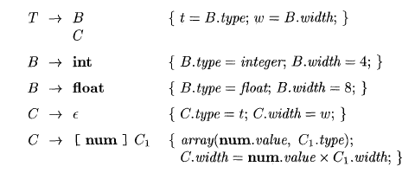
Storage Layout for Local Names
Computing types and their widths

Slide 191
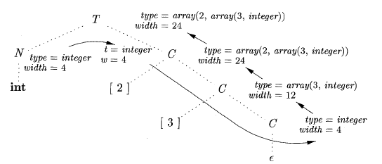
Storage Layout for Local Names
Syntax-directed translation of array types

Slide 192

Sequences of Declarations
Actions at the end:

Slide 193
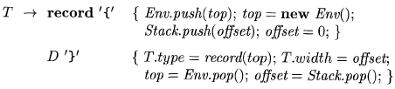
Fields in Records and Classes

Slide 194
Translation of Expressions and Statements
We discussed how to find the types and offset of variables
We have therefore necessary preparations to discuss about translation to intermediate code
We also discuss the type checking

Slide 195
Three-address code for expressions

Slide 196
Incremental Translation

Slide 197
Addressing Array Elements
Layouts for a two-dimensional array:

Slide 198
Semantic actions for array reference

Slide 199
Translation of Array References
Nonterminal L has three synthesized attributes:
L.addr
L.array
L.type

Slide 200
Conversions between primitive types in Java

Slide 201
Introducing type conversions into expression evaluation

Slide 202
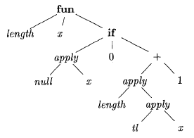
Abstract syntax tree for the function definition
fun length(x) =
if null(x) then 0 else length(tl(x)+1)
This is a polymorphic function
in ML language

Slide 203
Inferring a type for the function length

Slide 204
Algorithm for Unification

Slide 205
Unification algorithm
boolean unify (Node m, Node n) {
s = find(m); t = find(n);
if ( s = t ) return true;
else if ( nodes s and t represent the same basic type ) return true;
else if (s is an op-node with children s1 and s2 and
t is an op-node with children t1 and t2) {
union(s , t) ;
return unify(s1, t1) and unify(s2, t2);
}
else if s or t represents a variable {
union(s, t) ;
return true;
}
else return false;
}

Slide 206
Control Flow
boolean expressions are often used to:
Alter the flow of control.
Compute logical values.

Slide 207
Short-Circuit Code

Slide 208
Flow-of-Control Statements

Slide 209
Syntax-directed definition

Slide 210
Generating three-address code for booleans

Slide 211
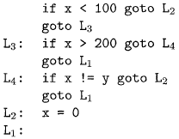
translation of a simple if-statement

Slide 212
Backpatching
Previous codes for Boolean expressions insert symbolic labels for jumps
It therefore needs a separate pass to set them to appropriate addresses
We can use a technique named backpatching to avoid this
We assume we save instructions into an array and labels will be indices in the array
For nonterminal B we use two attributes B.truelist and B.falselist together with following functions:
  makelist(i): create a new list containing only I, an index into the array of instructions
  Merge(p1,p2): concatenates the lists pointed by p1 and p2 and returns a pointer to the concatenated list
  Backpatch(p,i): inserts i as the target label for each of the instruction on the list pointed to by p

Slide 213
Backpatching for Boolean Expressions

Slide 214
Backpatching for Boolean Expressions
Annotated parse tree for x < 100 || x > 200 && x ! = y

Slide 215
Flow-of-Control Statements

Slide 216
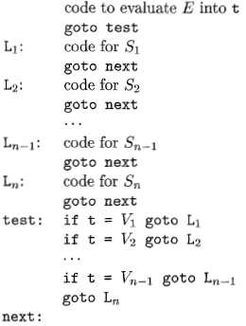
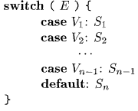
Translation of a switch-statement

Slide 217
Readings
Chapter 6 of the book

